Slide 1
Eggs by the Dozen
Tommy Williams, James, Aiden Steve, Donghwa Shin, Eddie Xiao
School of Engineering and Applied Sciences, University of Virginia
Nicole Duffala, Mo Wed 3:30-4:45
Font sizing examples:
Font size will look very different when printed on a poster. Remember, that some viewers may be standing some distance away from the poster. Keep in mind general accessibility guidelines when considering fonts as well (this is Aptos 72 point):
66pt – Font size will look very different printed on a poster.
60 pt – Font size will look very different printed on a poster.
54 pt – Font size will look very different printed on a poster.
48 pt – Font size will look very different printed on a poster.
40 pt – Font size will look very different printed on a poster.
36 pt – Font size will look very different printed on a poster.
28 pt – Font size will look very different printed on a poster.
12 pt – Font size will look very different printed on a poster (We use this when reading something up close, but on a poster this is way too small for anything except maybe including foot note references)
Poster Must Include:
Client Problem Definition/Overview and Background
Success Criteria and Limitations
Solution Description
Test results and analysis and conclusions
Recommendations and Future Work
Legible References in APA
Rules:
3 x 4 feet
Vertical or horizontal
No shaded backgrounds
Tables and Figures Labeled
Think about font size: see example
Include graphics as well as bullet points
You must bring physical prototype and/or computer if software solution

Slide 2
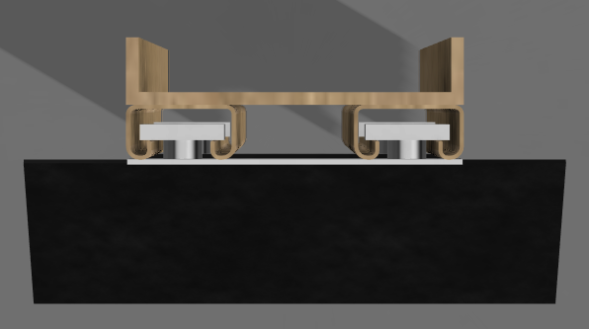
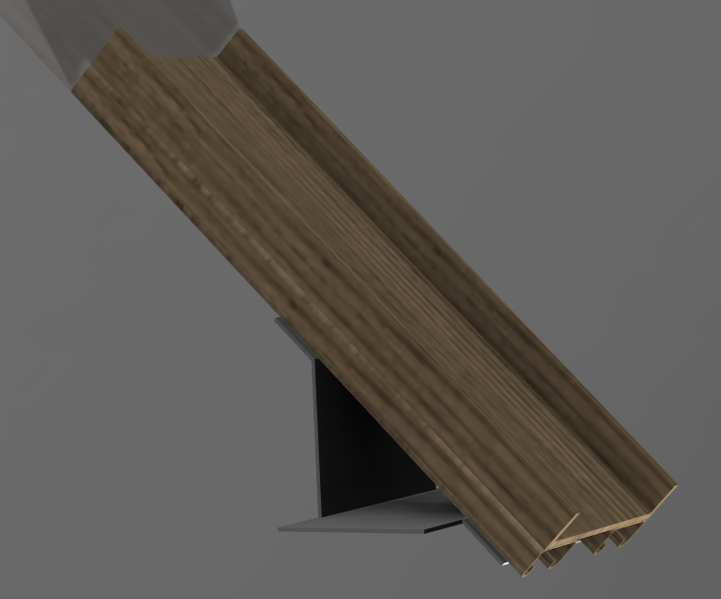
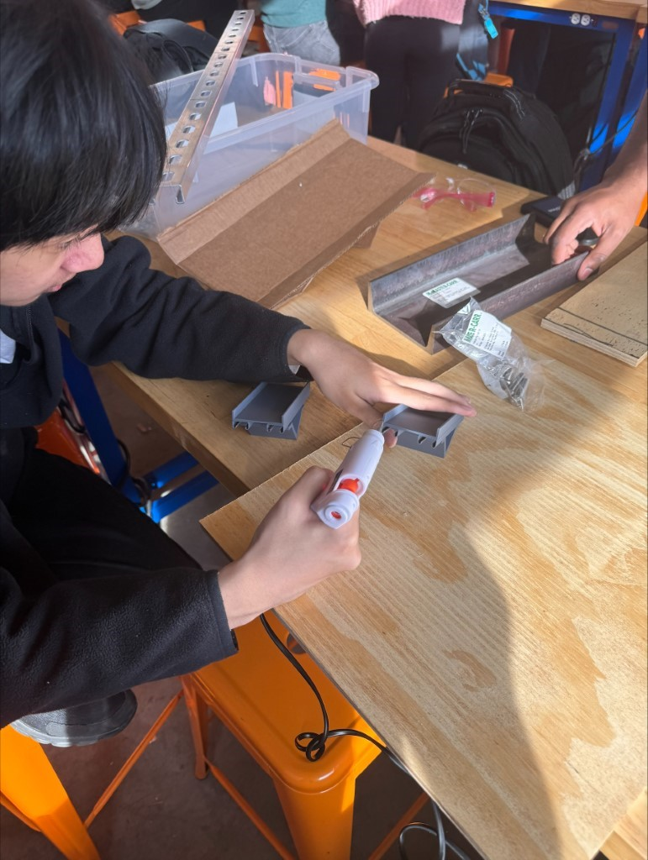
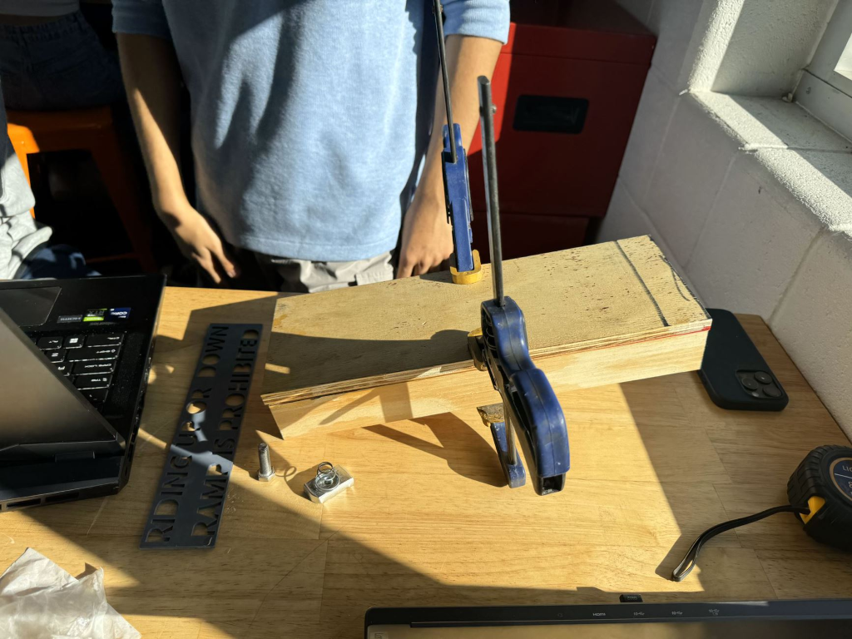
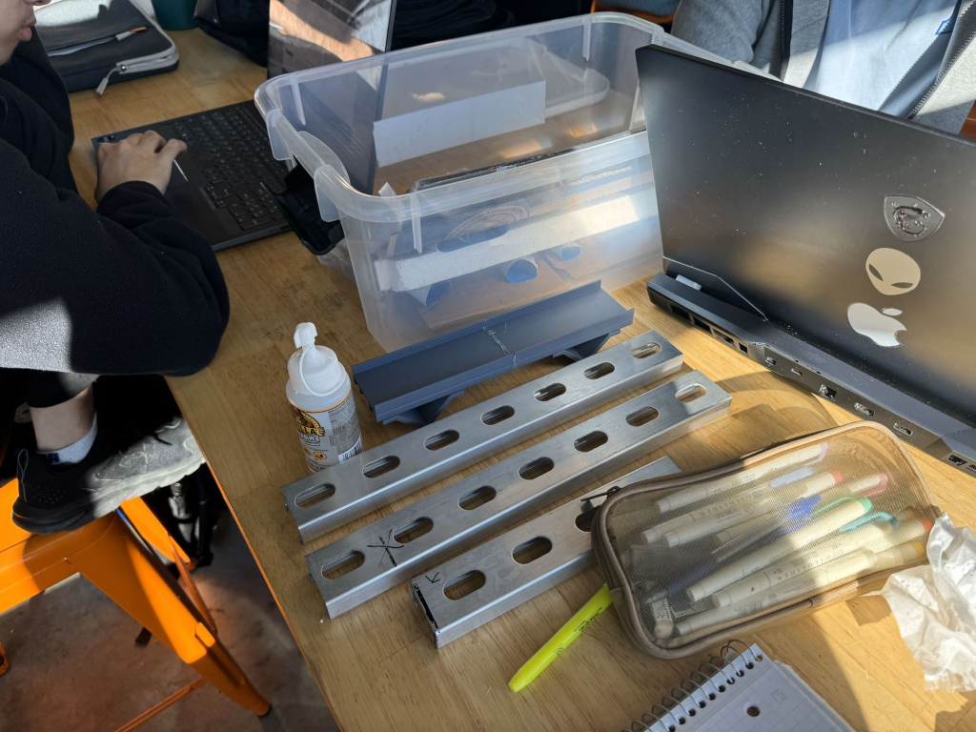
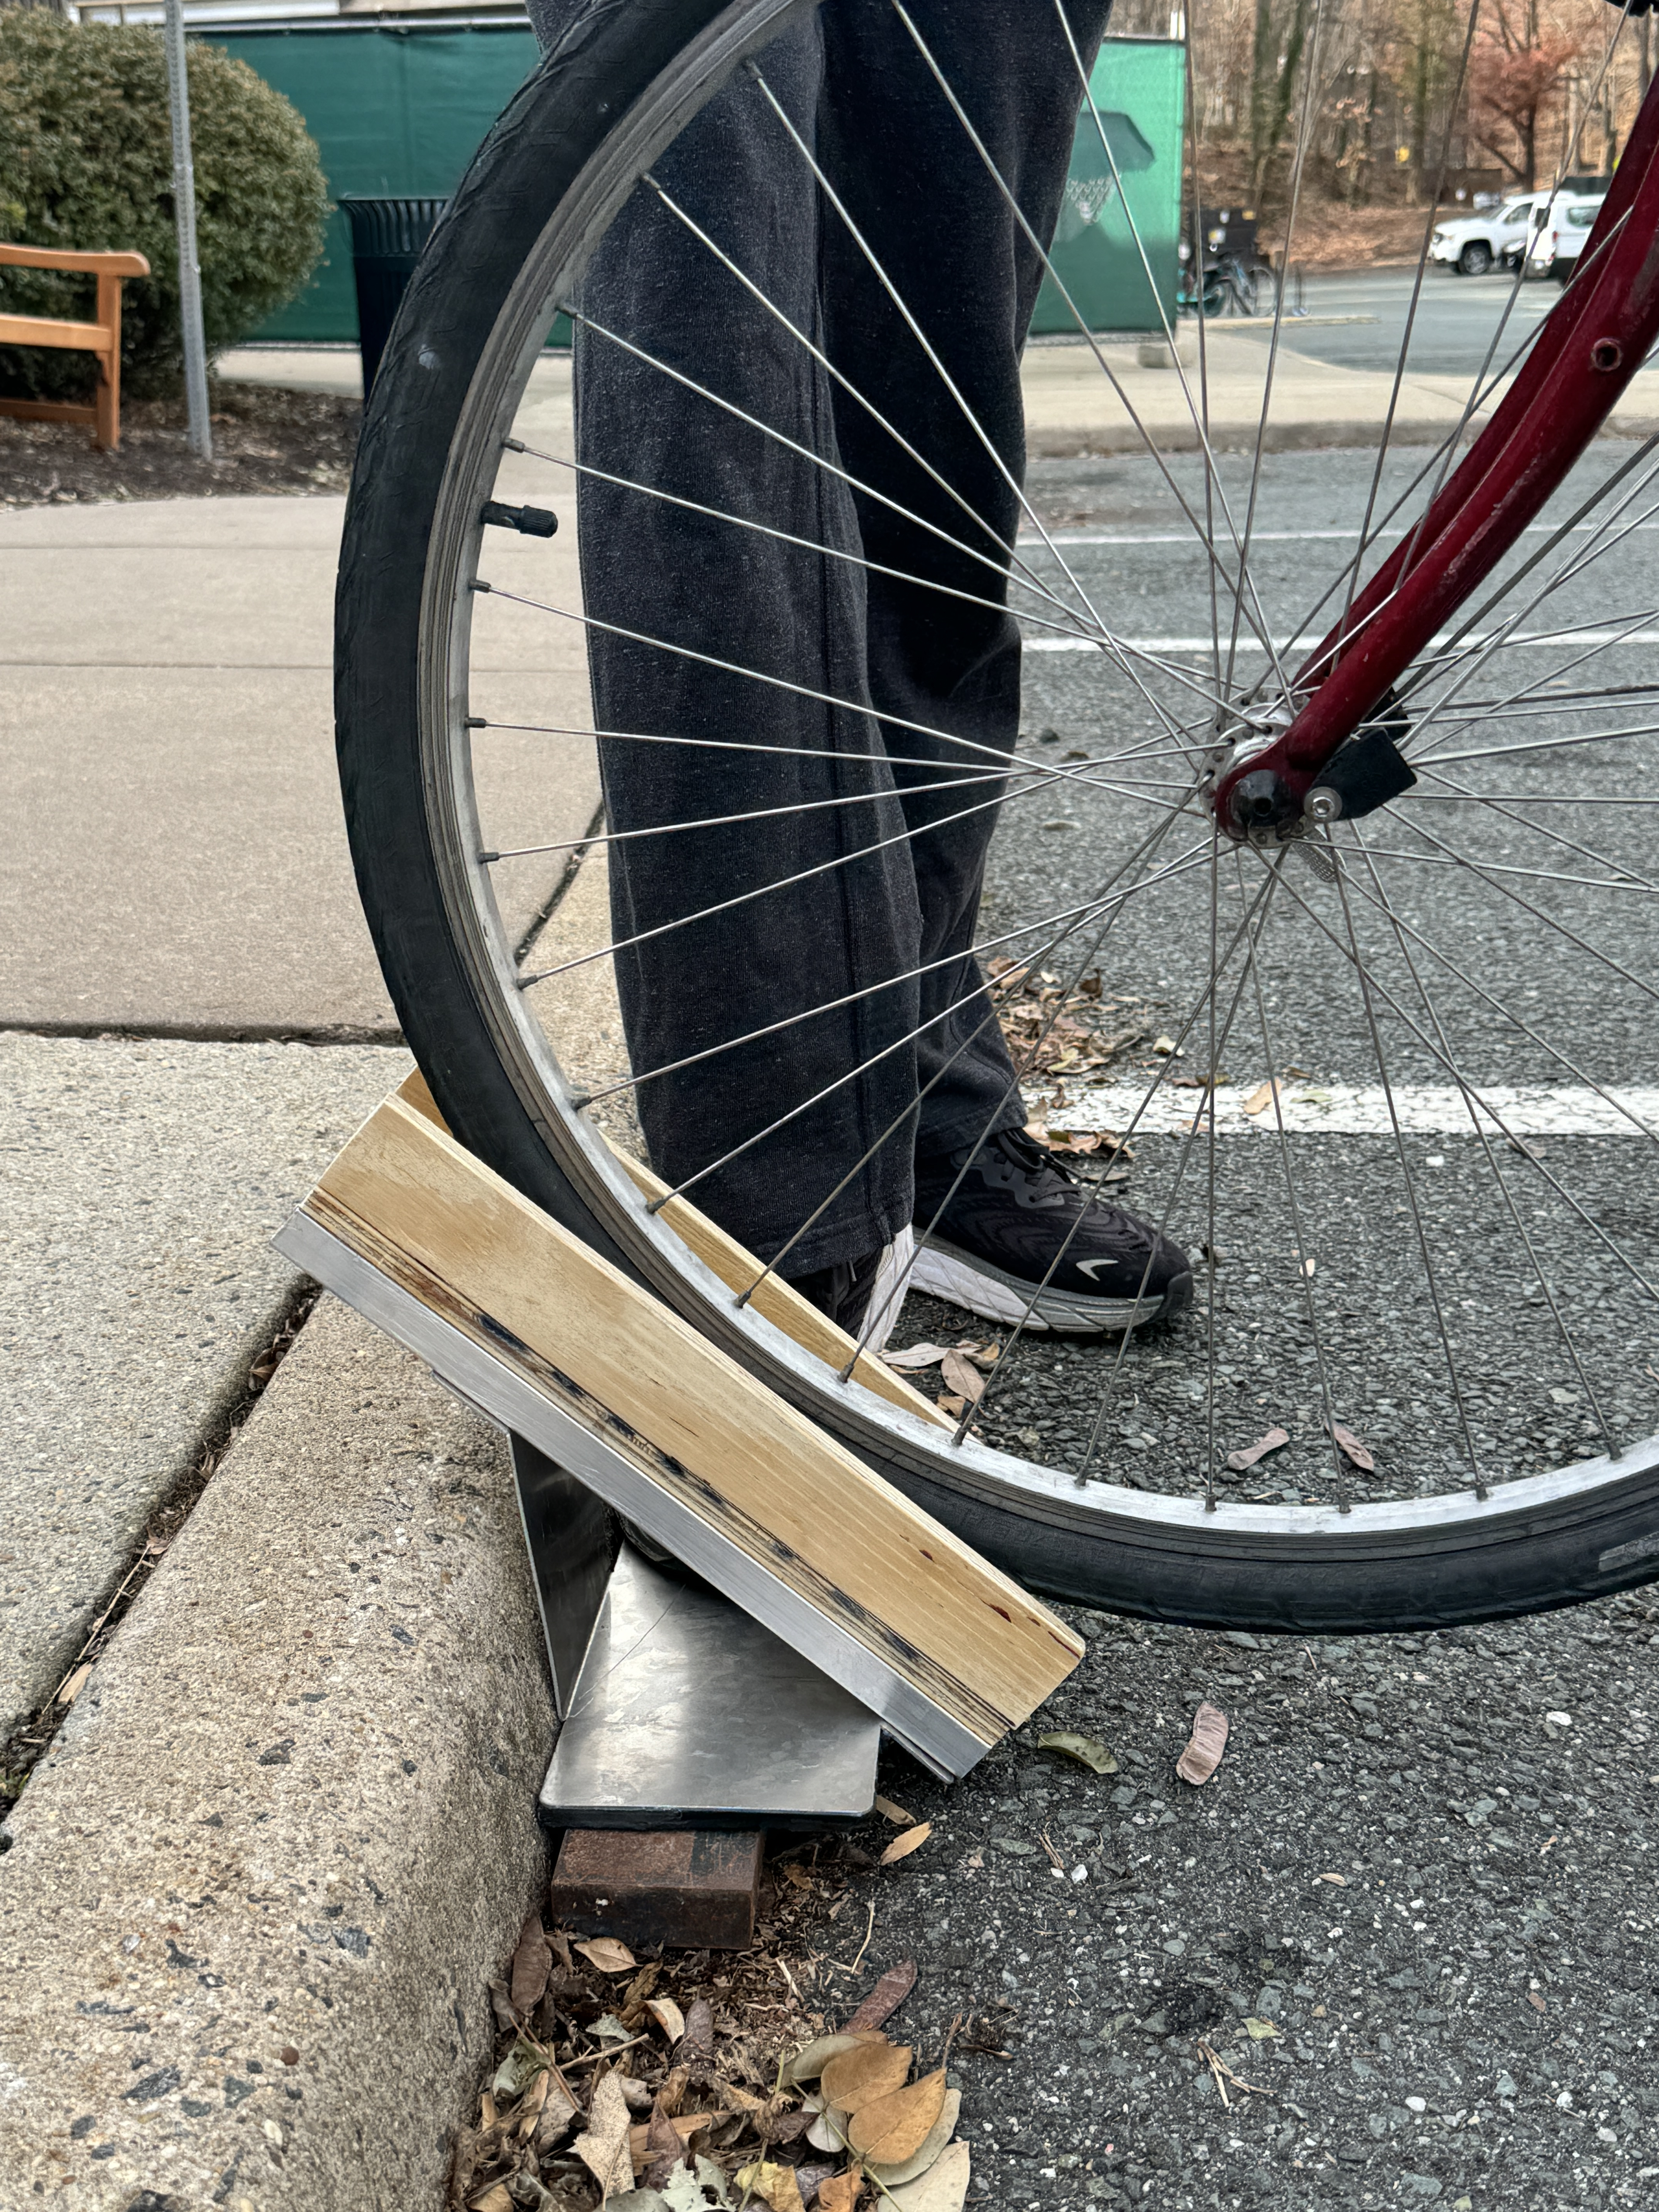
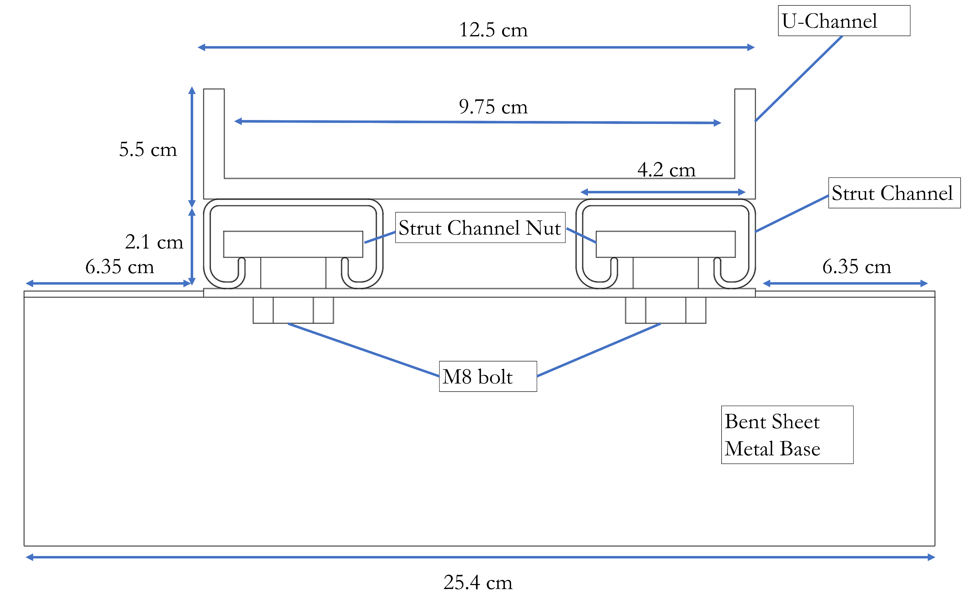
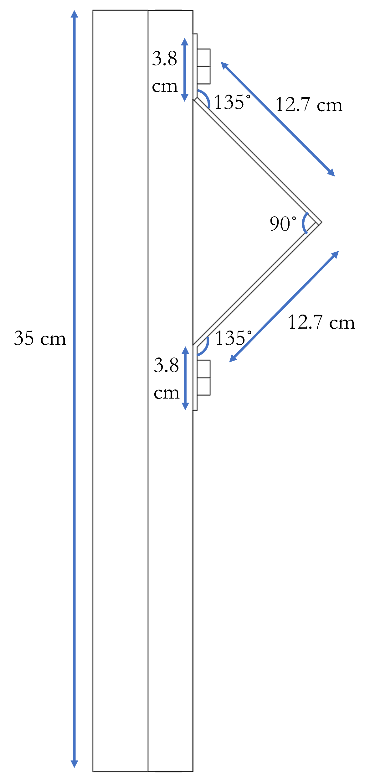
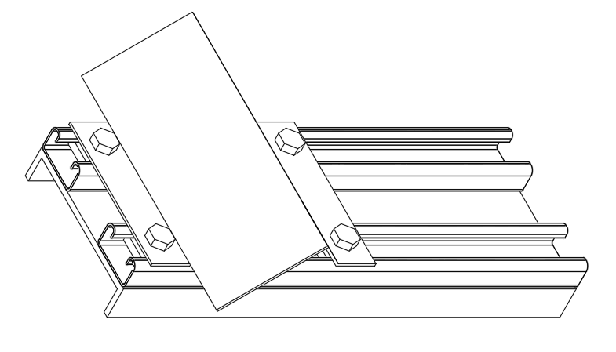
Eggs By The Dozen
A Solution to UVA’s Lack of Stair Accessibility for Bike and Scooter Riders
Aiden Ha, Donghwa Shin, Eddie Xiao, James Baker, Tommy Williams
Accessibility Problem: The client, Susan Skalak, a fiber farmer at Ringadal farm, faces a significant challenge in managing parasites, particularly barber pole worms, which pose a threat to the health of her sheep and goats, causing severe anemia and even death. To monitor and control these parasites, Susan currently relies on the Modified McMaster Test, an accurate but costly and time-consuming method performed by veterinarians. Seeking a more efficient solution, Susan seeks to develop an app that can analyze photos of McMaster slides with fecal solutions, accurately counting parasite eggs while distinguishing them from air bubbles. This app must be compatible with an iPhone 6, work offline, and provide faster and more cost-effective results than the current method, without compromising accuracy. By addressing these needs, Susan aims to streamline parasite management on her farm and improve the health and productivity of her livestock.The client, Susan Skalak, a fiber farmer at Ringadal farm, faces a significant challenge in managing parasites, particularly barber pole worms, which pose a threat to the health of her sheep and goats, causing severe anemia and even death. To monitor and control these parasites, Susan currently relies on the Modified McMaster Test, an accurate but costly and time-consuming method performed by veterinarians. Seeking a more efficient solution, Susan seeks to develop an app that can analyze photos of McMaster slides with fecal solutions, accurately counting parasite eggs while distinguishing them from air bubbles. This app must be compatible with an iPhone 6, work offline, and provide faster and more cost-effective results than the current method, without compromising accuracy. By addressing these needs, Susan aims to streamline parasite management on her farm and improve the health and productivity of her livestock.
Approach to Design Process:
Devised possible solutions and decided on an adjustable ramp system. Between several different ramp shapes to accommodate different wheel sizes or drainage, a u-channel was selected due to commercial availability.
Envisioned the design by creating a low fidelity prototype out of cardboard, foam, and tape.
After deciding specific dimensions, a CAD model was created, and a 3D printed prototype constructed to ensure the feasibility and practicality of the design.
A bill of materials was written based on CAD dimensions, and parts were ordered from the McMaster-Carr website.
Design was fabricated: U-channel was constructed out of wood, strut channels were cut and attached to u-channel, sheet metal was laser cut and bent, rubber sheet was cut and glued to sheet metal.
Design was tested using a commuter bicycle and succeeded.
Design testing: A weight was placed upon the base to simulate an extended ramp and more bases.
Success Criteria:
Reduce parasite-related health risks and mortality rates among Susan's sheep
Lower overall testing costs
Provide timely and reliable results
Enhance operational efficiency
Empower Susan Skalak and Ringadal Farm with a comprehensive and sustainable approach to parasite monitoring
Ensure the welfare and productivity of her livestock
Optimize resource utilization
Design Constrains:
Fits inside a 46 x 31.1 x 17.8 cm box
Constructed from materials more sustainable than concrete
Attaches to staircase without foundation or concrete anchors
Fabricated Design:
✔️ Handles wheel size up to 9.75 cm width
✔️ Polyurethane adhesive, wood, steel, aluminum
✔️ Adjustable by loosening/tightening nut in strut channel
✔️ Angle adjusted by placing shims between strut channel and metal base
✔️Pushing bike/scooter up/down ramp is safer than carrying it
✔️ Ramp design facilitates maneuvering
✔️ Dimensions span 35 x 25.4 x 17.75 cm
✔️ Polyurethane adhesive, wood, steel, aluminum
✔️ Extended rubber sheet helps ramp grip into concrete
Rubber Sheet
Technical Description of Solution:
Our solution is a low-fidelity prototype featuring a feature-based algorithm written in C++ and leveraging the OpenCV library to detect and quantify barber worm eggs in microscopic fecal samples of goats. The algorithm preprocesses images by converting them to grayscale, applying Gaussian blur to reduce noise, and utilizing Canny edge detection to highlight potential egg boundaries. Contour detection is then employed to identify candidate blobs resembling barber worm eggs. These contours are analyzed based on geometric properties and color filtering to distinguish them from irrelevant shapes. Selected contours undergo further analysis, including ellipse fitting to confirm egg identification. Each identified egg is counted and multiplied by 100 to estimate parasite egg load per gram, with annotated output images for verification. Post-development, securing a free domain for hosting our web application ensures long-term accessibility for our client without financial burden.
Performance Data:
During design testing, the commuter was able to push the bicycle up a curb using the fabricated design. Therefore, if the design was extended to fit a full-size staircase, it could plausibly work.
Though the design meets all success criteria and fits the constraints, there are several design improvements that can be made to enable the design to work across more staircases.
In future iterations of the design, the design should be altered such that it is:
More easily adjustable to different stair angles instead of using shims (Look to adjustable bike seat post design)
Fits more step sizes (Stair riser height ranges from 4 to 7 inches, stair tread is a minimum of 11 inches (International Code Council, 2021) (Alter base dimensions)
Altered materials for increased weather resistance
References:
Blazewick, D. H., Chounthirath, T., Hodges, N. L., Collins, C. L., & Smith, G. A. (2018). Stair-related injuries treated in United States emergency departments. The American Journal of Emergency Medicine, 36(4), 608–614. https://doi.org/10.1 016/j.ajem.2017.09.034
Chu, S. (2023). Decarbonizing Virginia’s Industrial Pollution with Low-Carbon Concrete. Virginia Conservation Network. https://vcnva.org/agenda-item/decarbonizing- virginias-industrial-pollution-with-low-carbon- concrete/
Manager, R. (2022, November 1). How Much Does an Electric Bike Weigh? Ride1UP. https://ride1up.com/how-much-does-an- electric- bike-weigh/
International Code Council. (Nov. 2021) “2018 INTERNATIONAL BUILDING CODE (IBC) | ICC DIGITAL CODES.” Codes.iccsafe.org, https://codes.iccsafe.org/content/IBC2018P6/
chapter-10-means-of-egress#IBC2018P6_Ch10
_Sec1011.

Slide 3

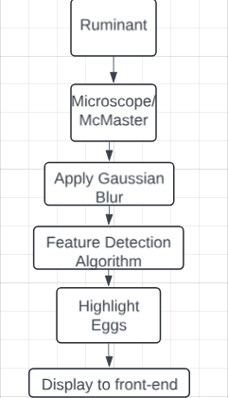
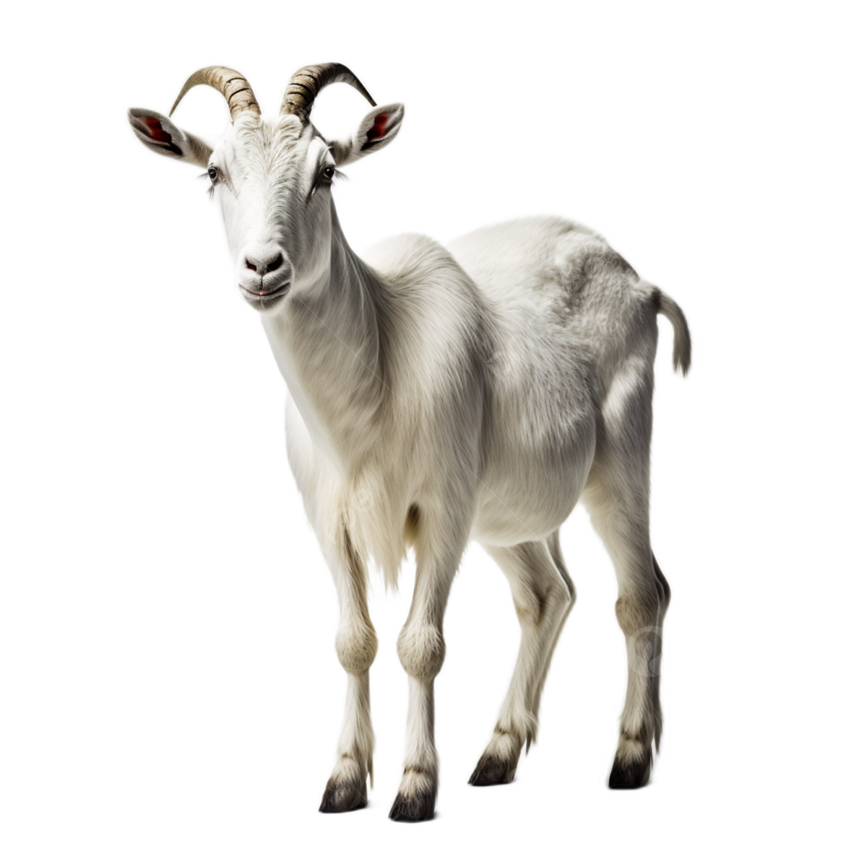
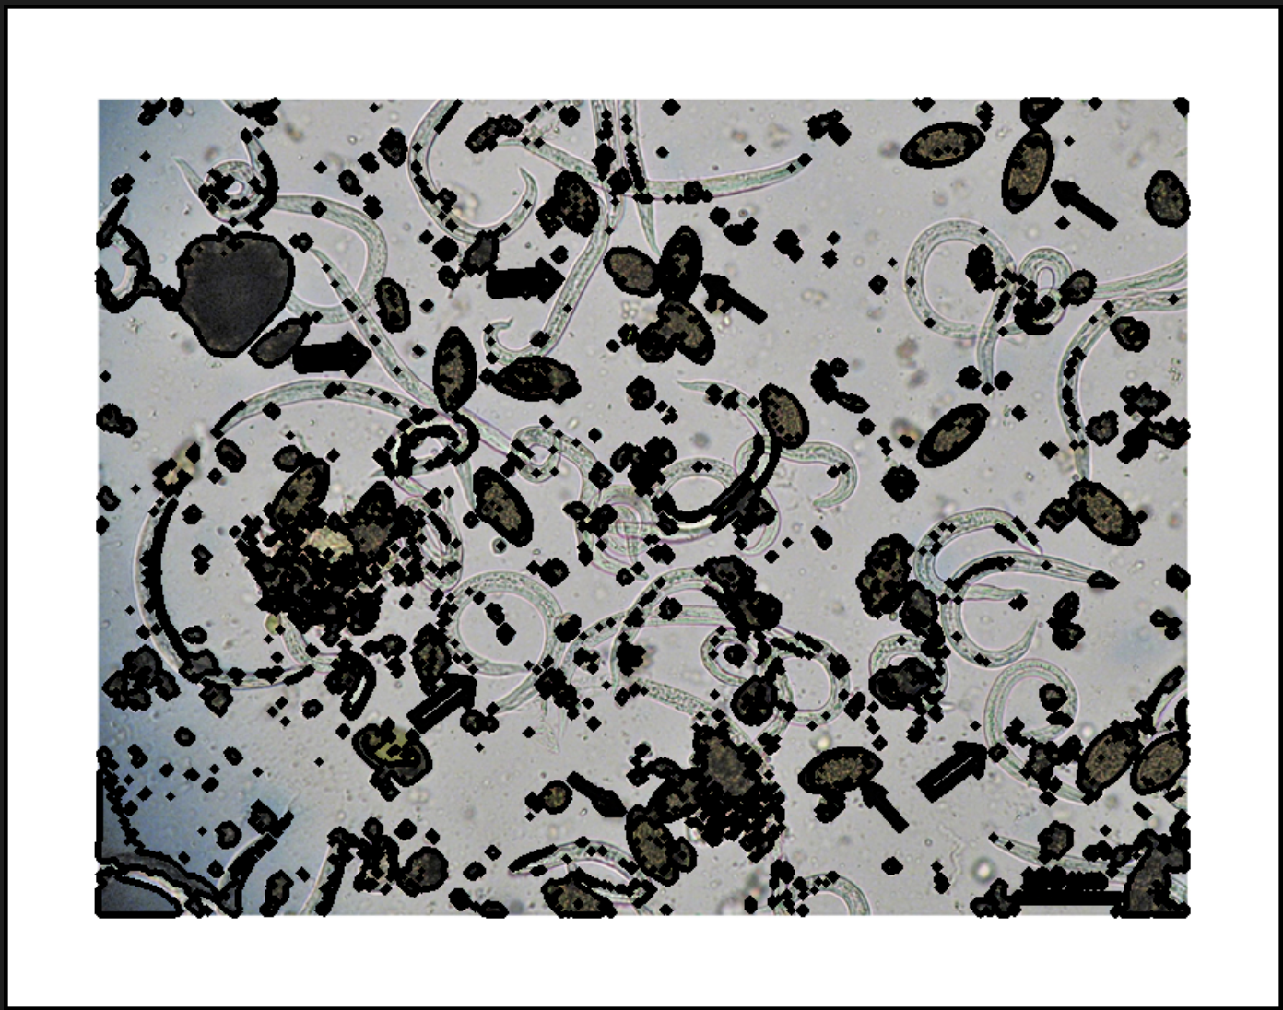

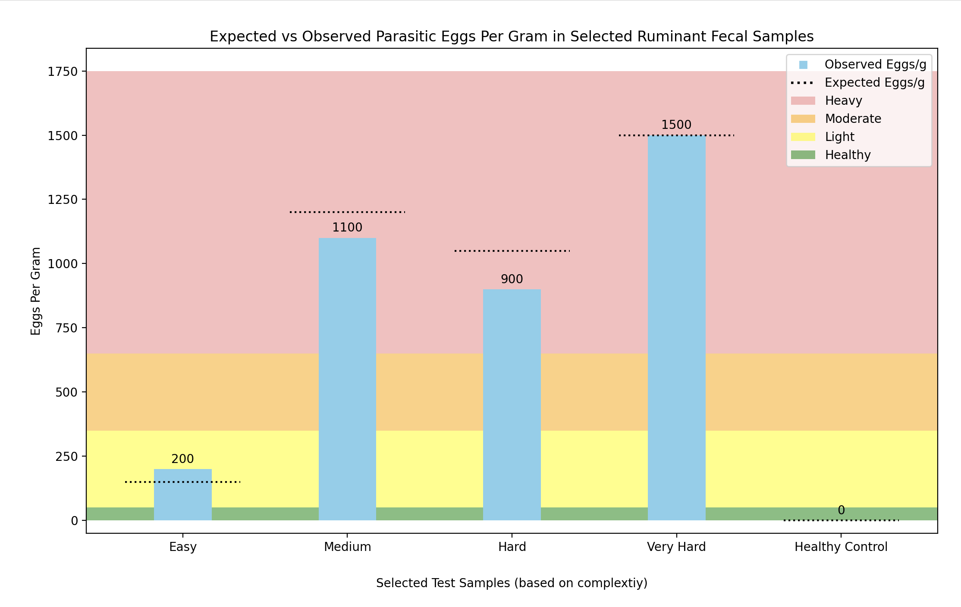
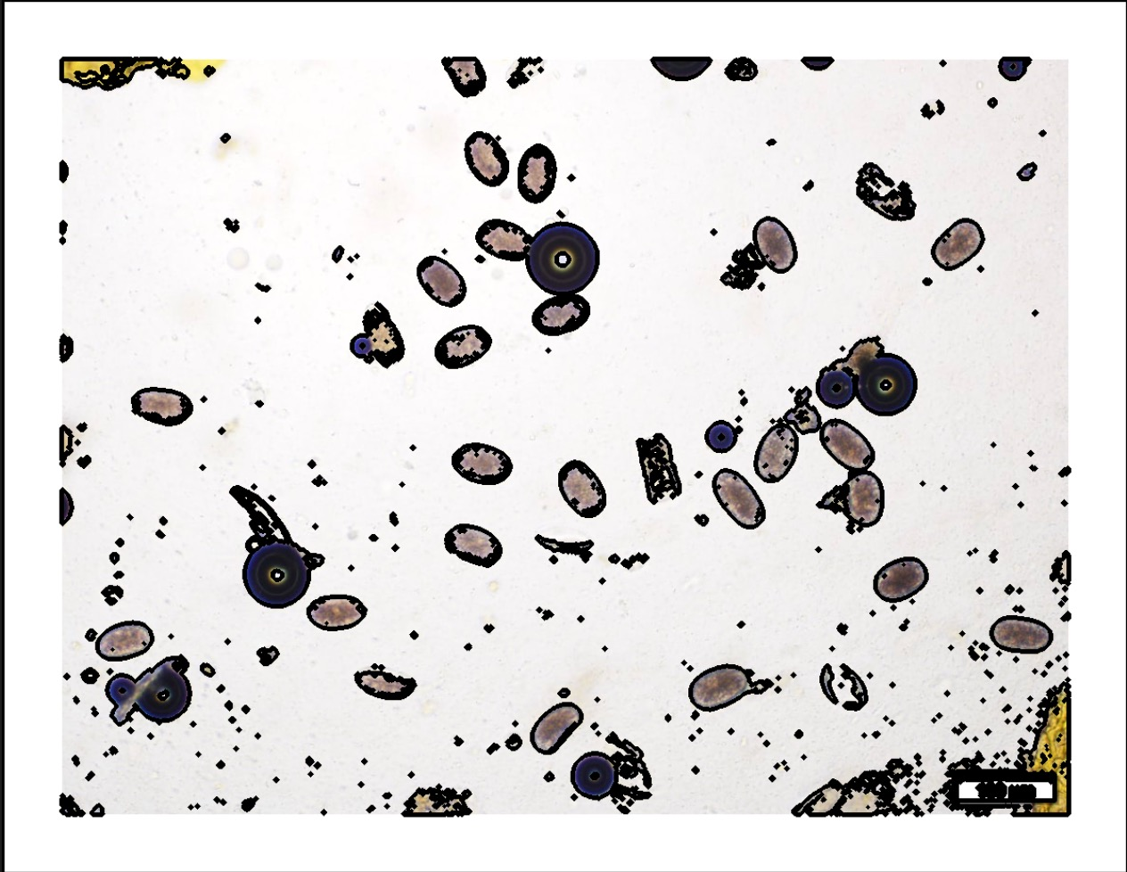
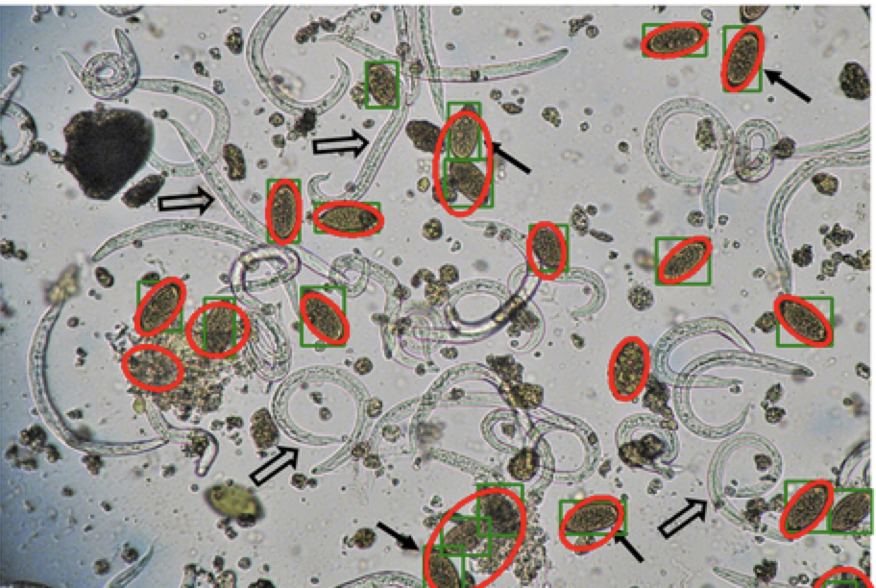
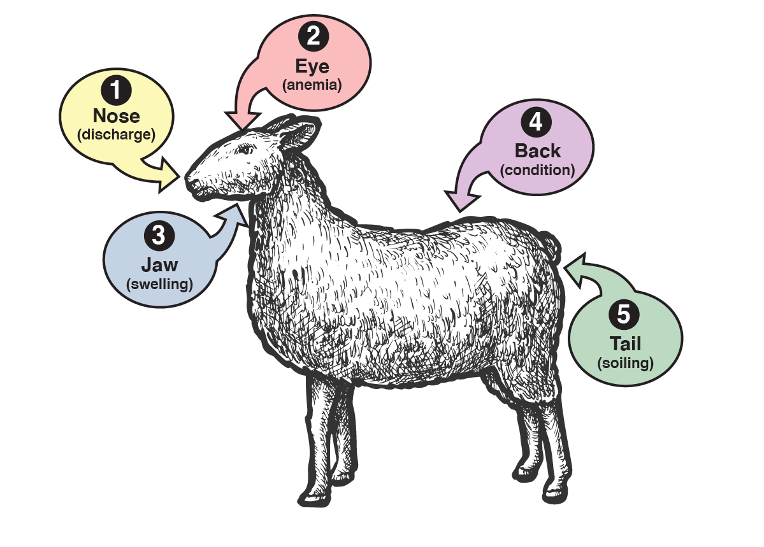
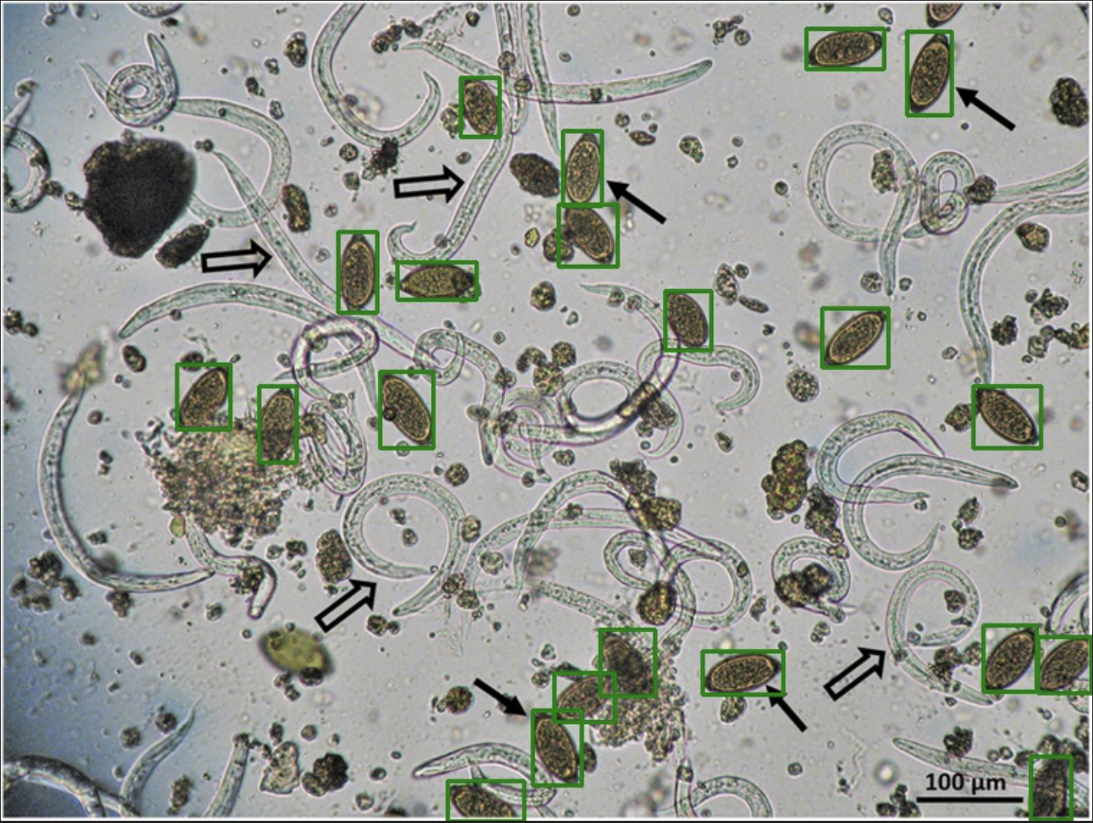
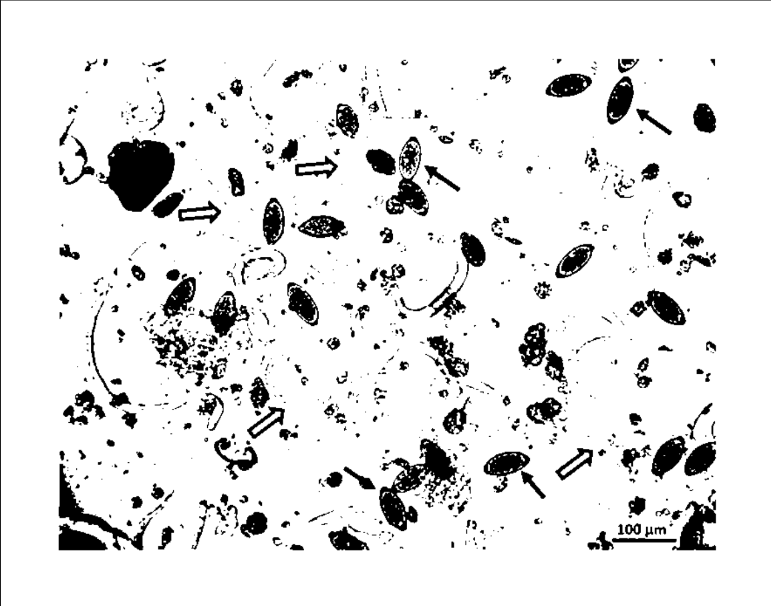
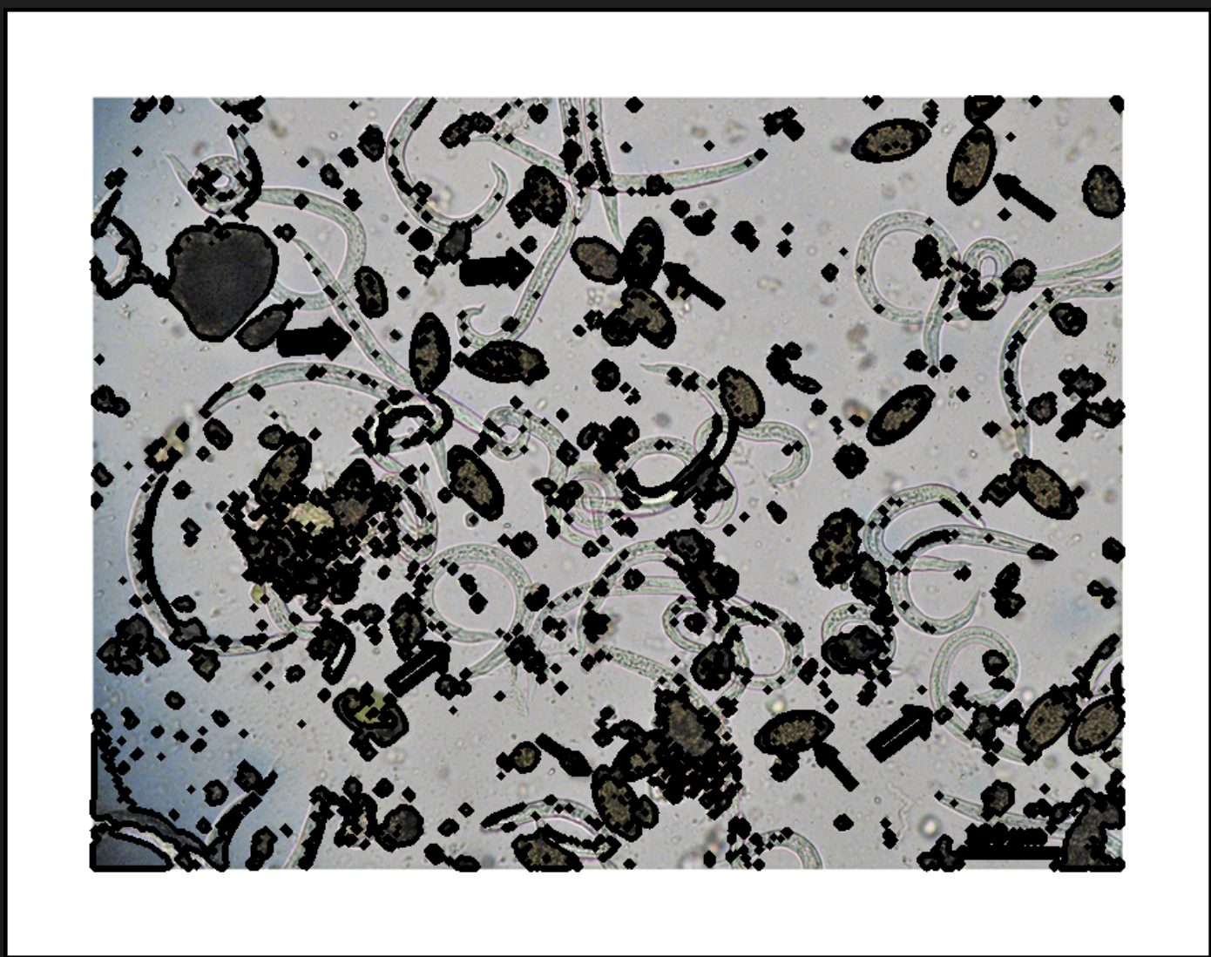
Eggs By the Dozen
An Algorthmic Solution To Fast and Accurate Ruminant Fecal Parasite Detection
James Baker, Aiden Ha, Donghwa Shin, Tommy Williams, Eddie Xiao
Client Problem Definition
Problem Definition:
Susan Skalak of Ringadal Farm needs an efficient solution for monitoring parasites in her sheep, particularly barber pole worms.
Background
Traditional fecal examination methods are time-intensive and require specialized skills.
Fecal egg counting methods include FLOTAC and McMaster, with FLOTAC showing superior performance.
FLOTAC offers higher accuracy but requires more complex procedures and equipment.
Contemporary Advances
Automation in fecal egg counting aims to reduce manual labor, save time, and eliminate human error.
Early automation efforts faced challenges in differentiating parasite eggs from fecal particles.
Methods and Approach to Design Process
Basic Solution Design Structure
Generates a binary image based on an algorithmically optimized intensity threshold (Fig 4)
Extracts elliptical contours with features optimized to the general shape of fecal parasite eggs (Fig 5)
Quantifying Error and Algorithm Improvements
Based on Shalak's criteria to minimize type 2 error, we derived the
Test Results and Conclusion
Success Criteria & Limitations
Objective of the Team:
To create a reliable, accurate and cheap method to detect and count parasite eggs in fecal samples of goats and sheep, that specifically minimizes undetected, infected goats.
The success of the solution will be determined by:
Lower overall testing costs than $16 per test.
Timely and reliable results, faster than two weeks
Be as or more accurate than the current parasite detection method.
Solution should operate natively and provide timely, reliable results.
Beta-Version Software Details
Feature extraction algorithm leveraging OpenCV and a novel parameter optimization algorithm
Hosting on a live website at https://eggbydozen.adaptable.app
Success Metric Analysis
✔️ $0 Cost Per Test and is accessible to anyone.
✔️ Displays results in less than 10 seconds.
✔️ Correctly diagnoses ruminant health condition (in terms of infestation severity) for all test samples.
✔️ Web-Hosted and Native Application versions available.
Future Work
Work Reflection:
We would not do anything differently as our current solution works as intended, detecting parasites within an image.
Next Steps:
1. Enhance Accuracy: Conduct further testing and improve the algorithm.
2. Expand Parasite Detection: Many animals have a similar problem. We will explore the feasibility of expanding the algorithm to detect other common parasites.
3. User Experience Enhancement: Introduce additional features to and improve the visual appeal of the website.
4. Mobile Application Deployment: Begin development of mobile application in order to improve user accessibility and marketability.
Citations:

Slide 4
Eggs By the Dozen
James Baker, Aiden Ha, Donghwa Shin, Tommy Williams, Eddie Xiao
Client Problem Definition
Problem Definition:
Susan Skalak of Ringadal Farm needs an efficient solution for monitoring parasites in her sheep, particularly barber pole worms.
Background
Traditional fecal examination methods are time-intensive and require specialized skills.
Fecal egg counting methods include FLOTAC and McMaster, with FLOTAC showing superior performance.
FLOTAC offers higher accuracy but requires more complex procedures and equipment.
Contemporary Advances
Automation in fecal egg counting aims to reduce manual labor, save time, and eliminate human error.
Early automation efforts faced challenges in differentiating parasite eggs from fecal particles.
Technical Description
A feature-based algorithm written in Python
Leverages the OpenCV library to detect and quantify barber worm eggs
Utilizes free domain for hosting our web application ensures long-term accessibility for our client without financial burden.
Total Cost per image: $0 Total Time per image: 30 seconds
Test Results and Conclusion
Future Work
Work Reflection:
We would not do anything differently as our current solution works as intended, detecting parasites within an image.
Next Steps:
1. Enhance Accuracy: Conduct further testing and improve the algorithm.
2. Expand Parasite Detection: Many animals have a similar problem. We will explore the feasibility of expanding the algorithm to detect other common parasites.
3. User Experience Enhancement: Introduce additional features to and improve the visual appeal of the website.
4. Mobile Application Deployment: Begin development of mobile application in order to improve user accessibility and marketability.
Success Criteria & Limitations
Objective of the Team:
Create a solution to the problem: a reliable, accurate and cheap method to detect parasites.
The success of the solution will be determined by:
Lower overall testing costs than $16 per test.
Timely and reliable results, faster than two weeks
Be as or more accurate than the current parasite detection method.
Solution should operate natively and provide timely, reliable results.
Citations:

Slide 5
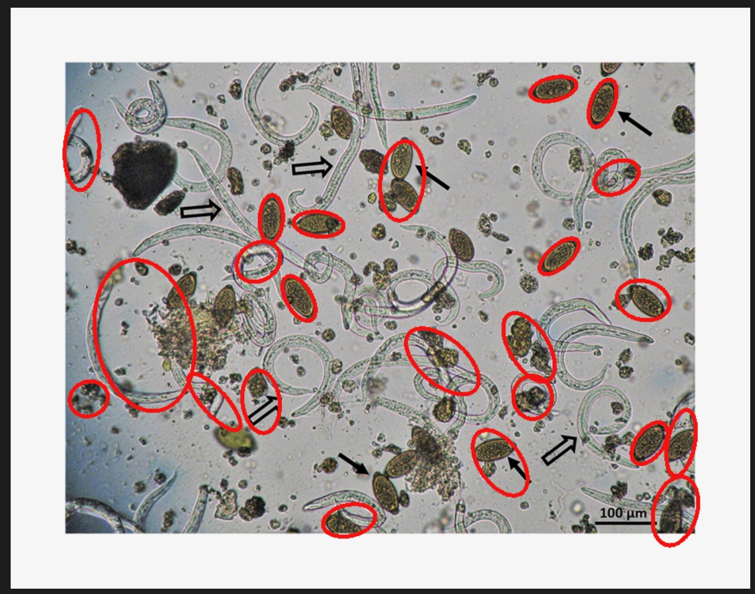
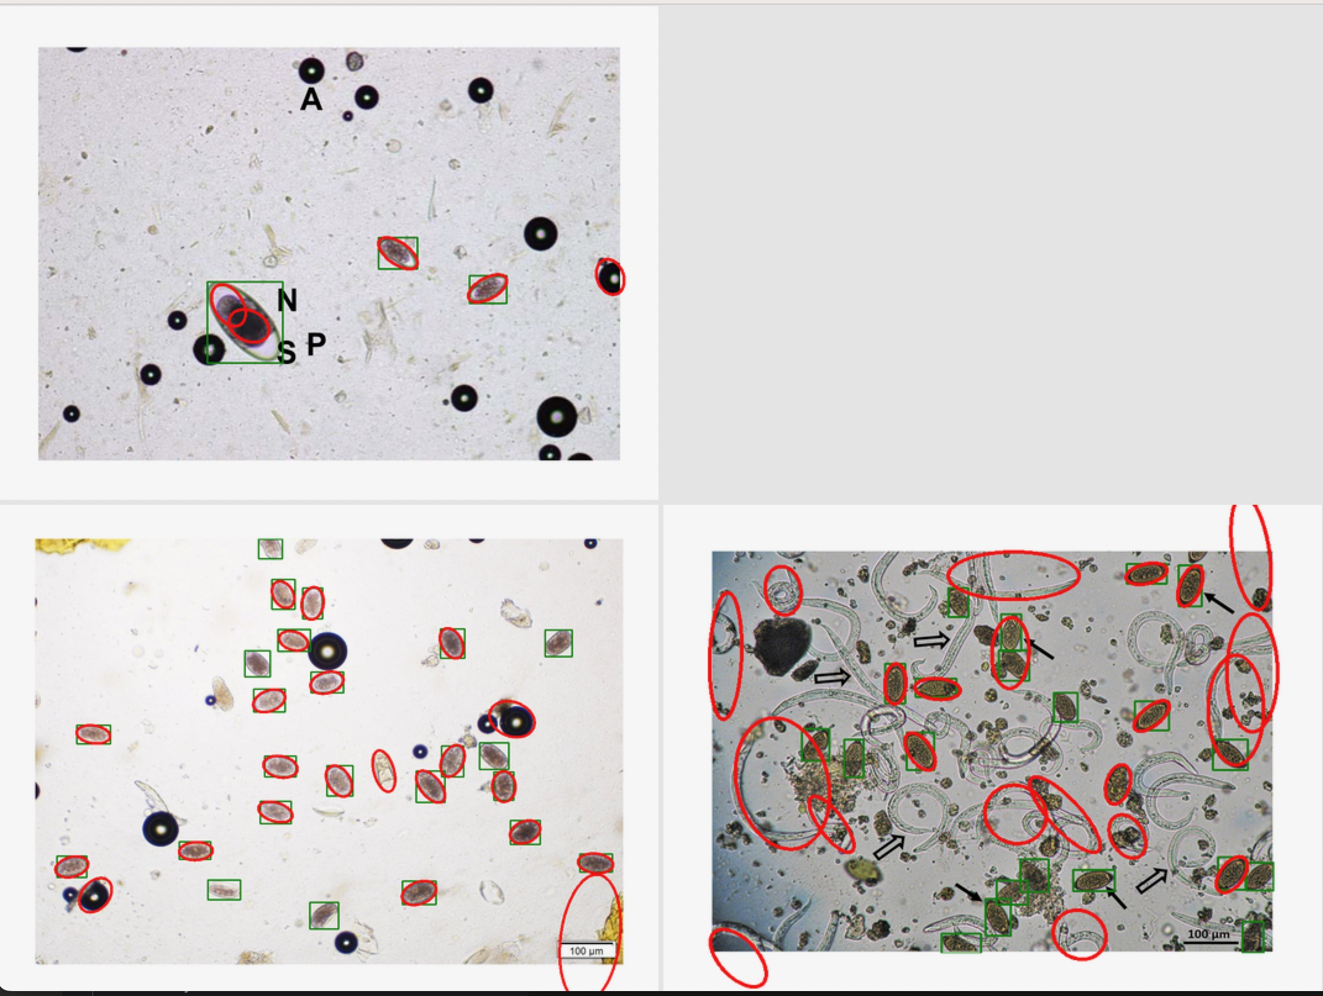
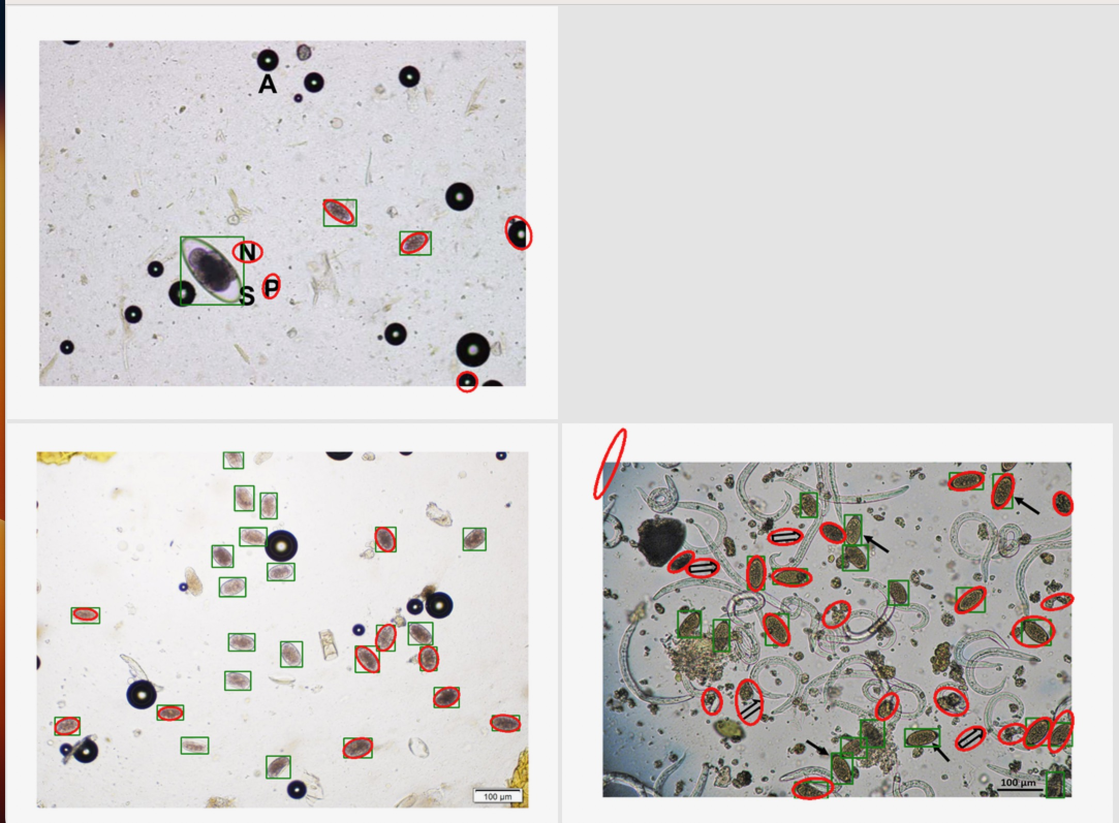
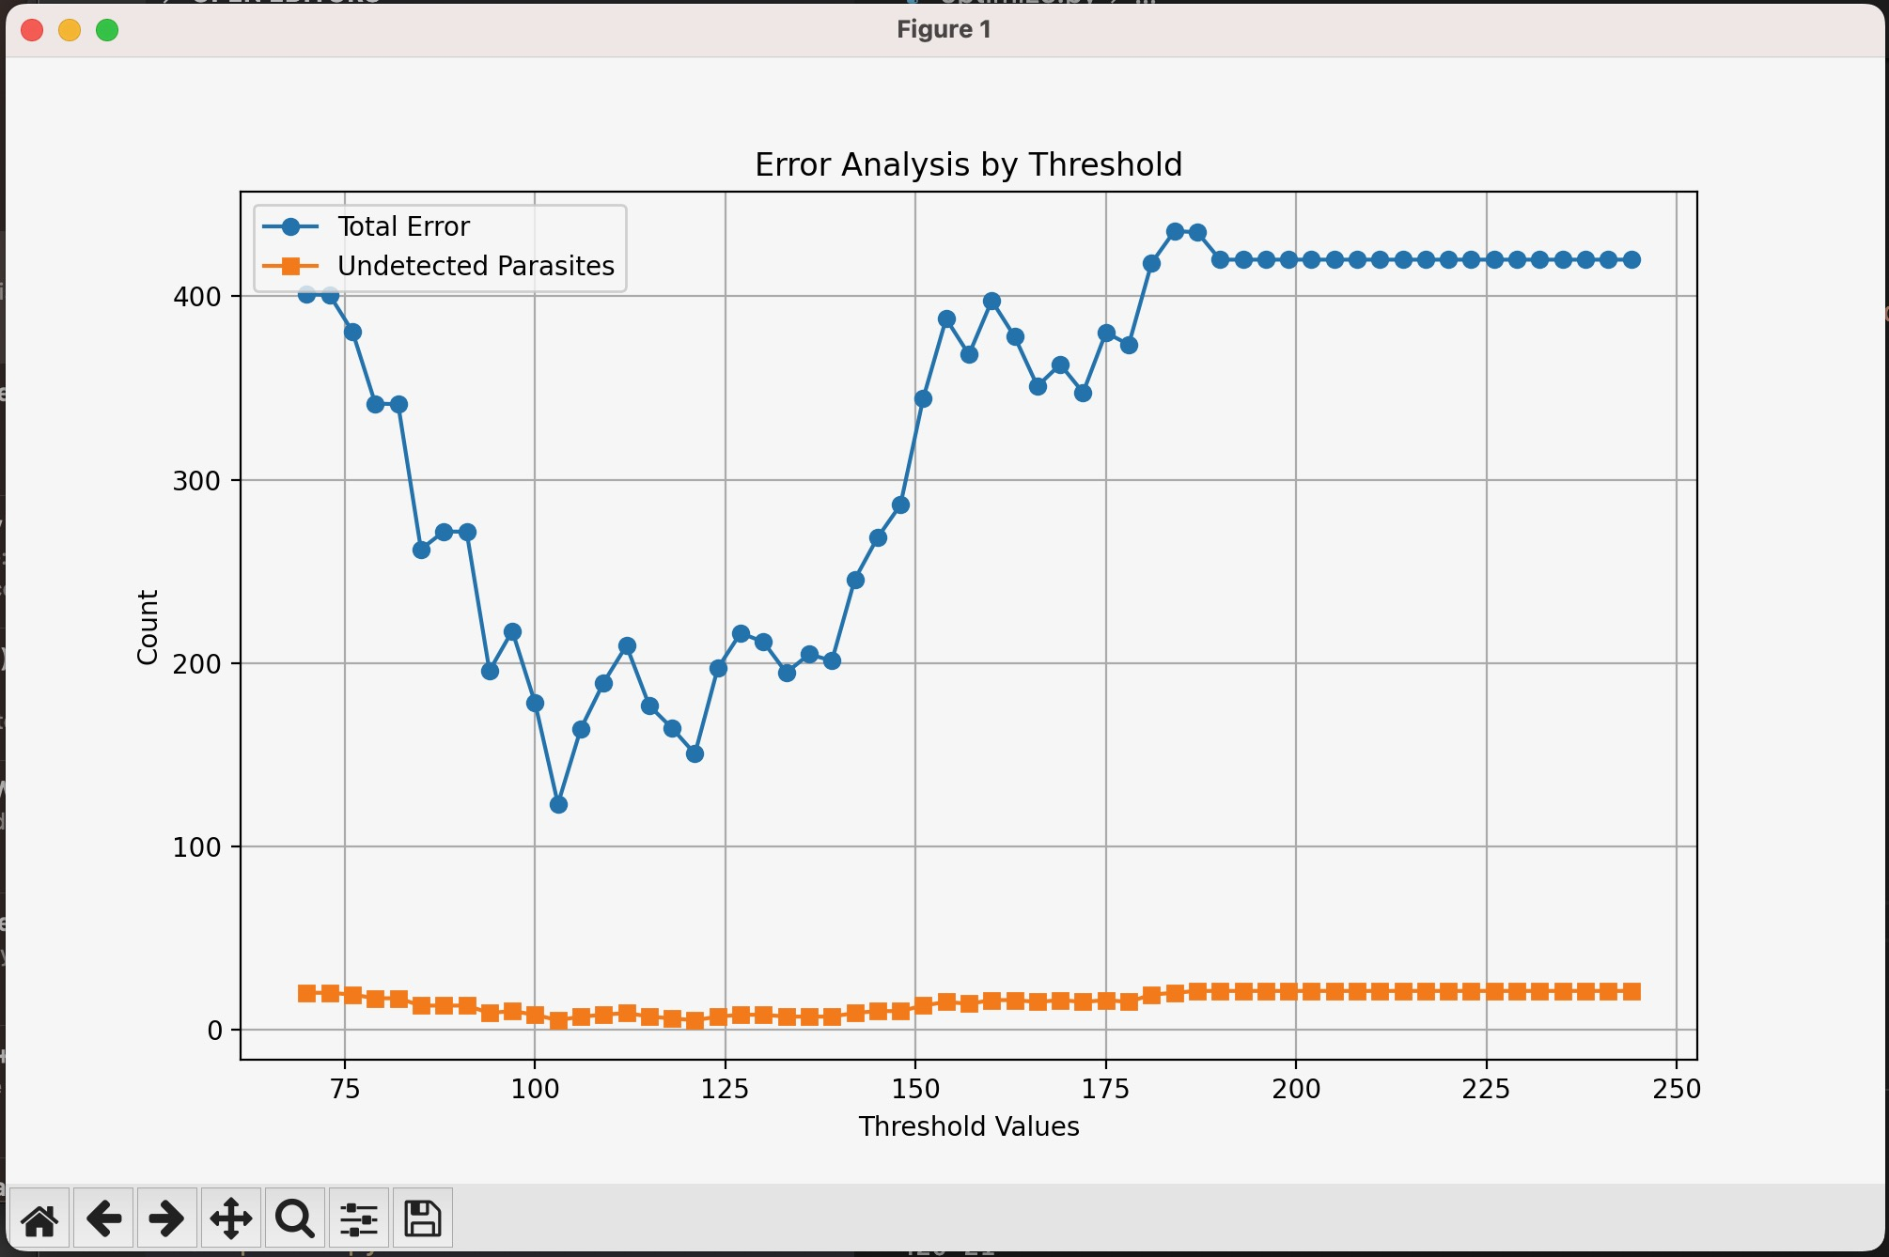
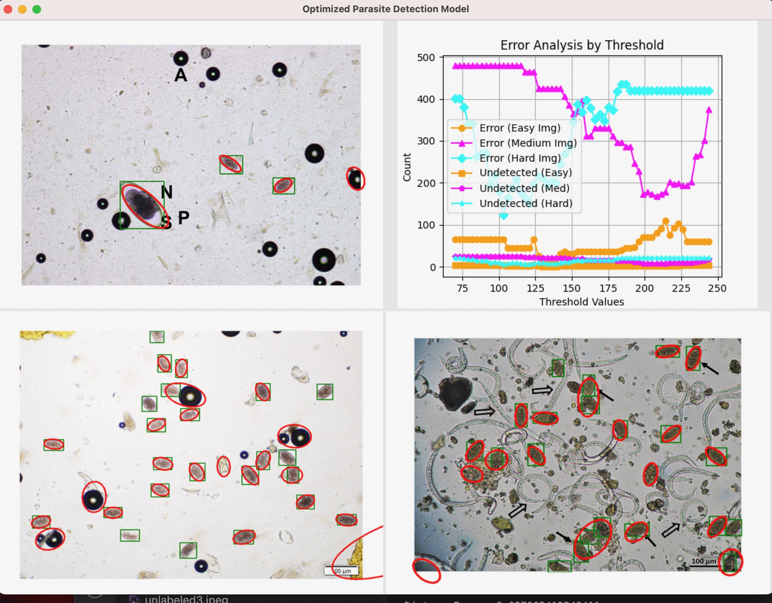
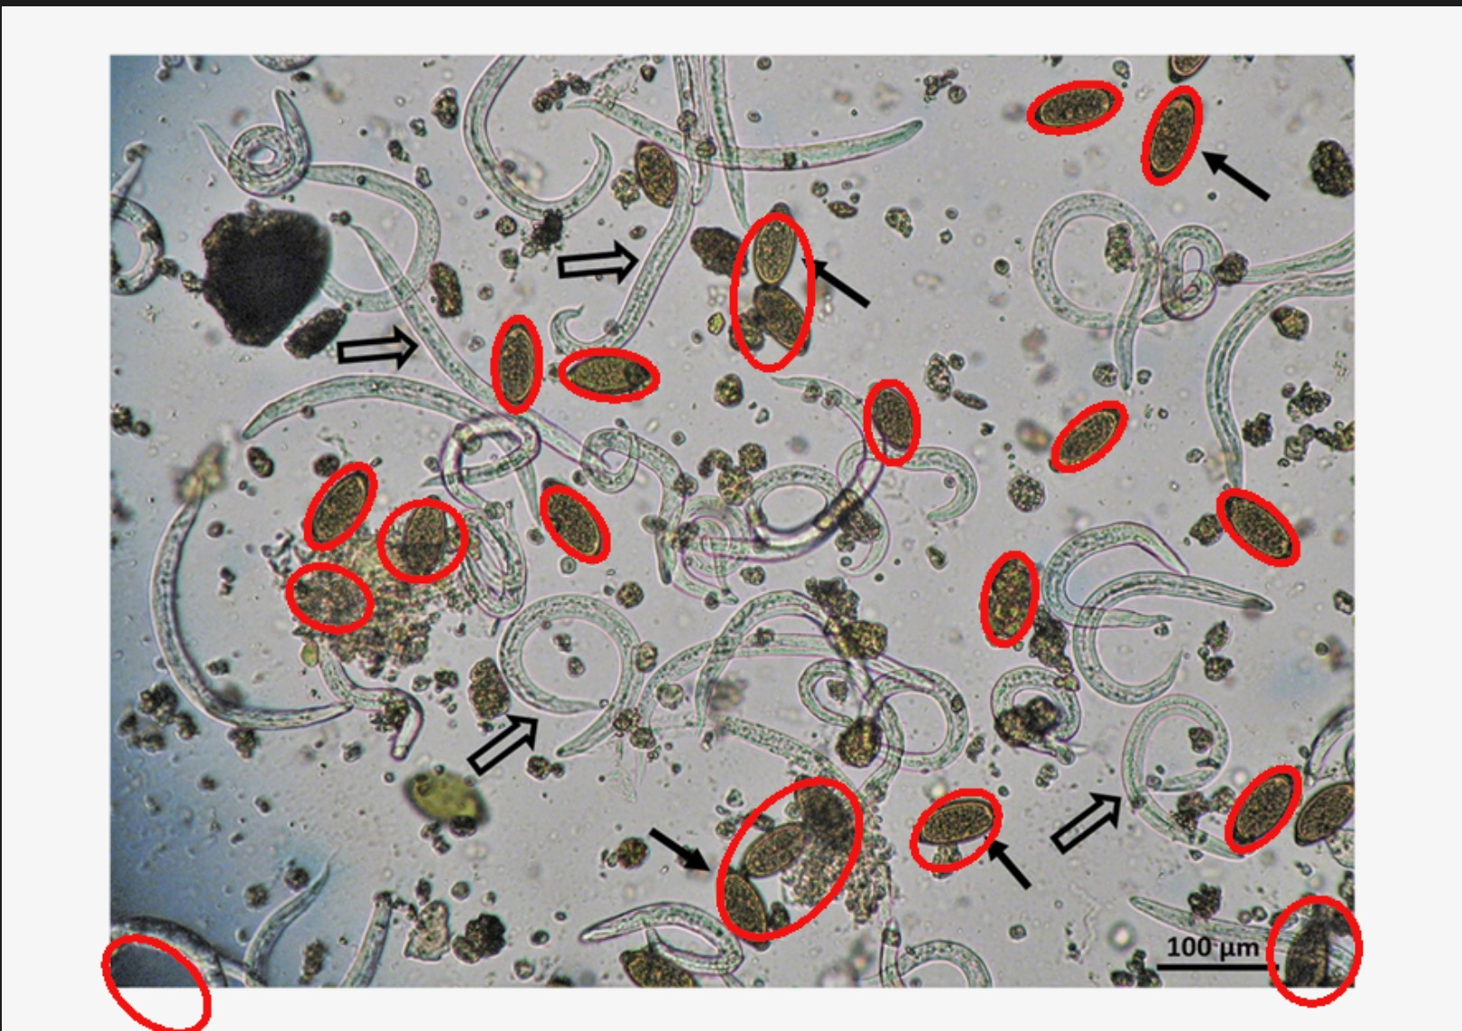
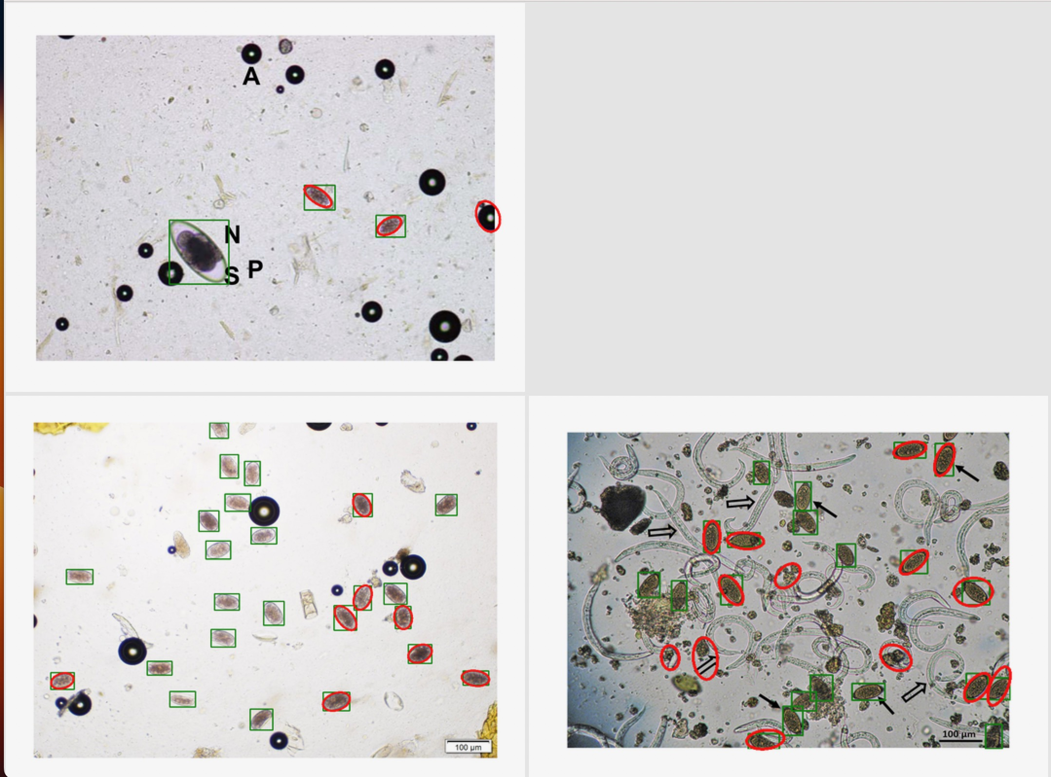
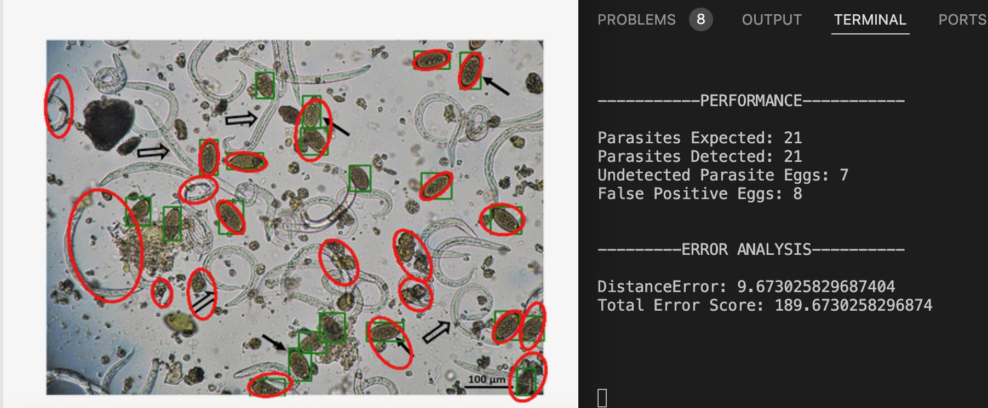

Slide 6
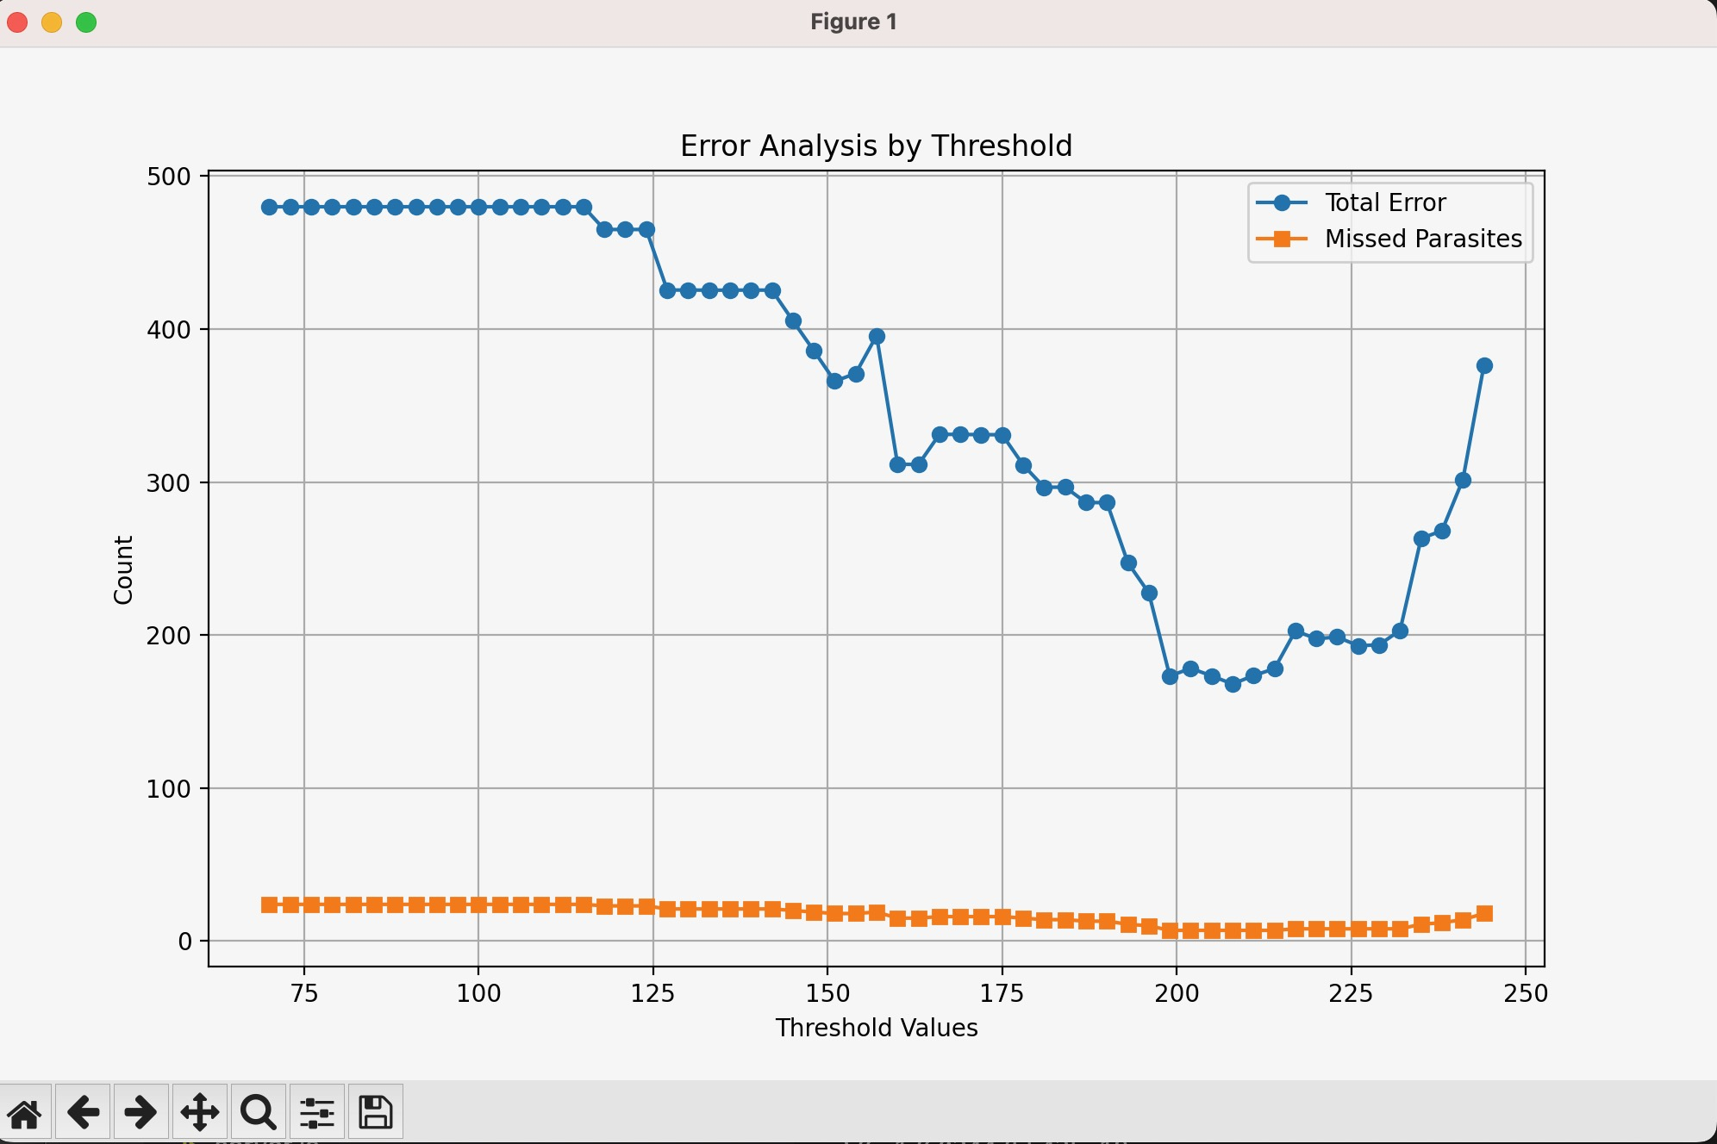
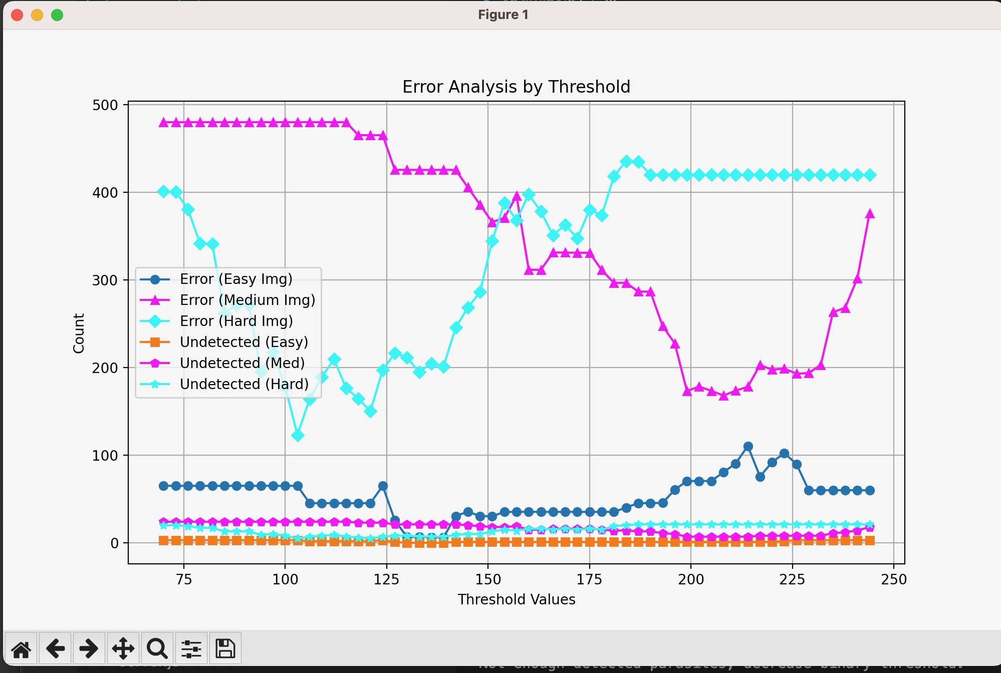
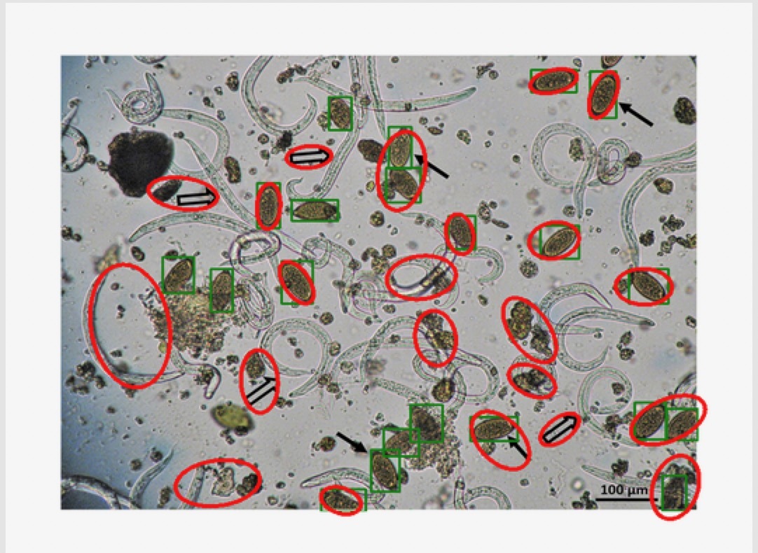
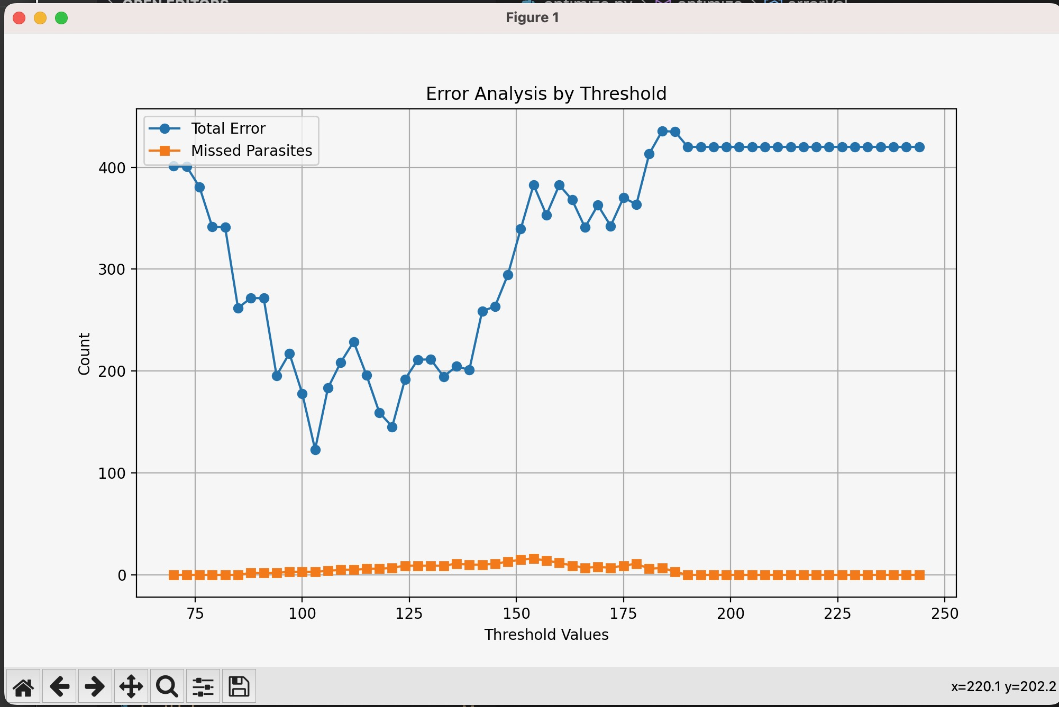
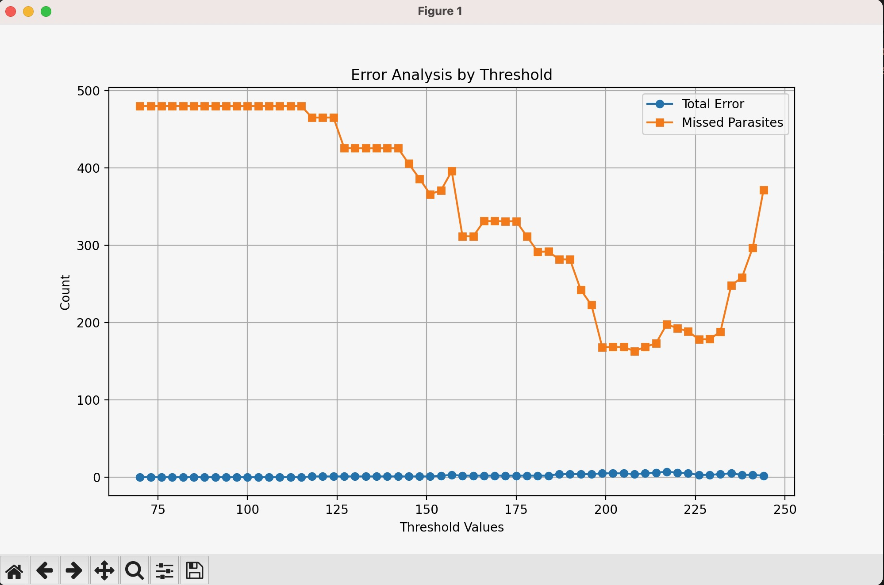

Slide 7
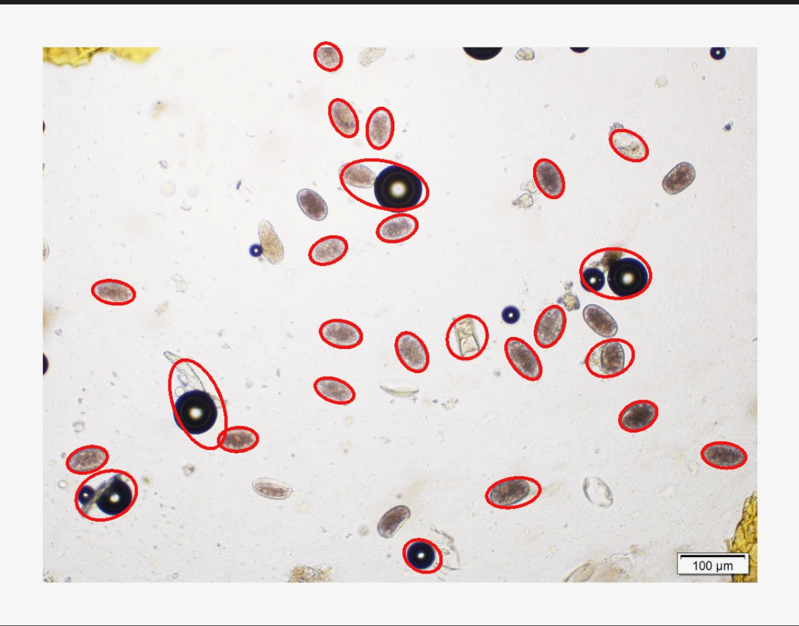
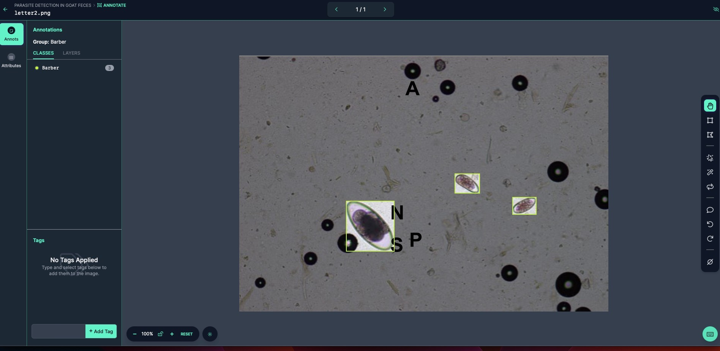
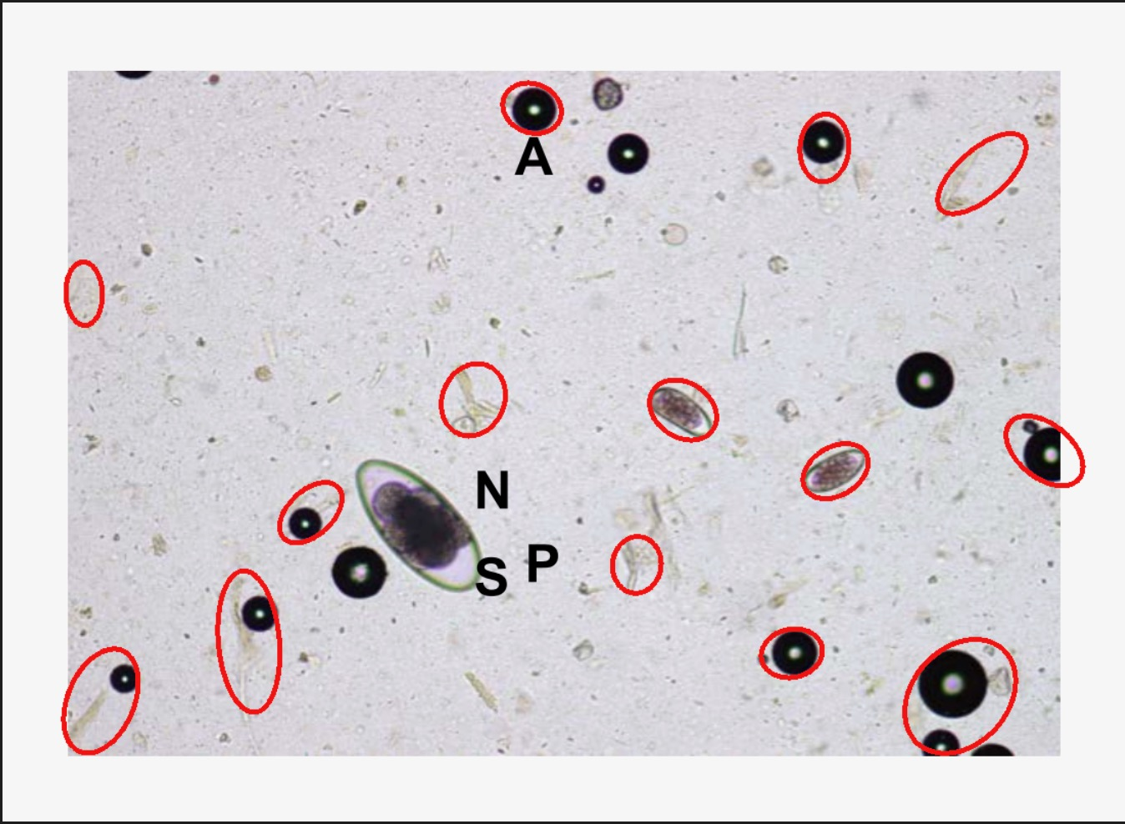
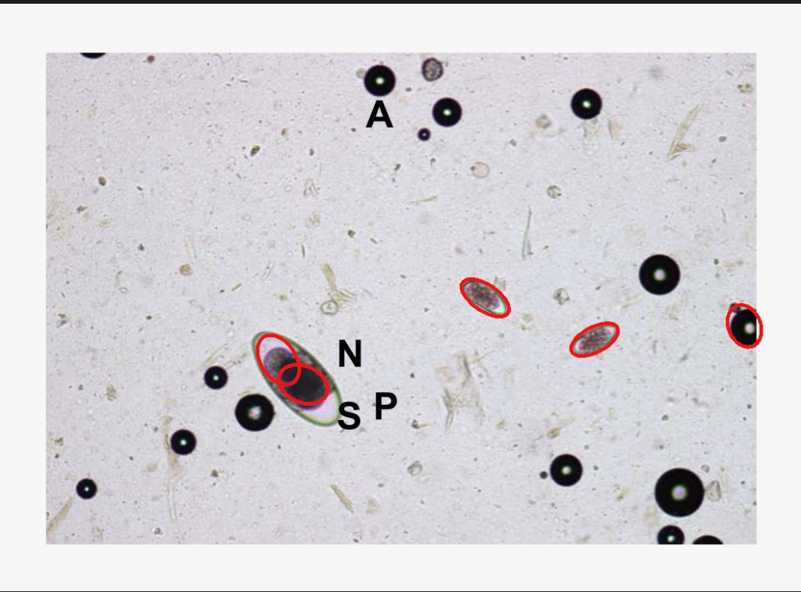
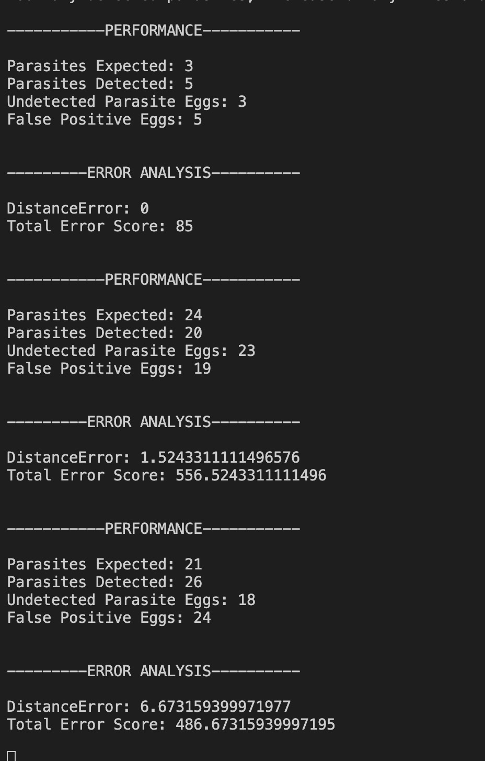
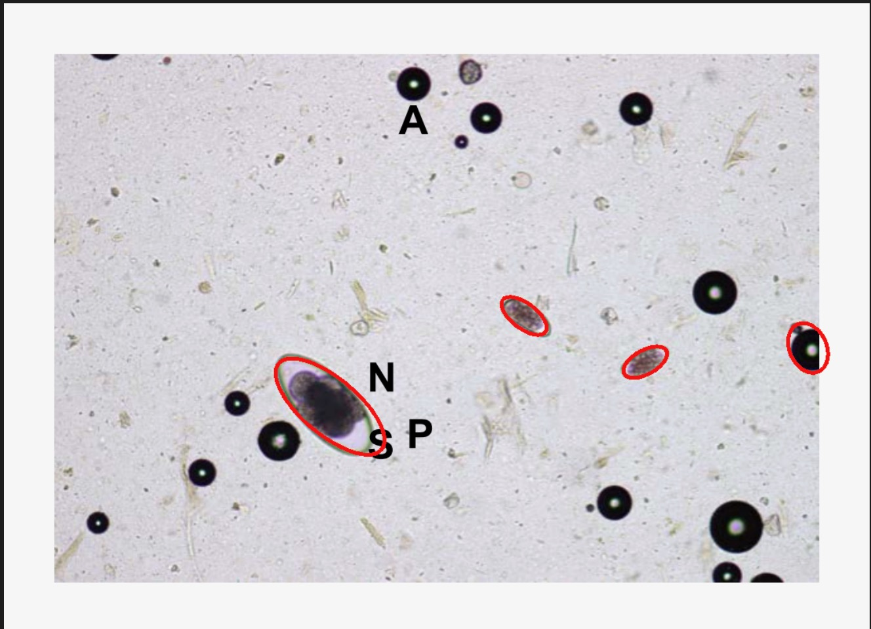


Slide 8

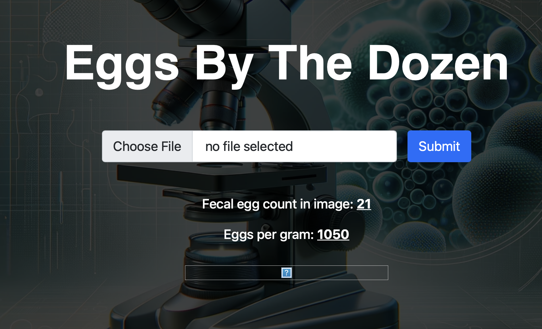

Slide 9
Client problem
The client, Susan Skalak, a fiber farmer at Ringadal farm, faces a significant challenge in managing parasites, particularly barber pole worms, which pose a threat to the health of her sheep and goats, causing severe anemia and even death. To monitor and control these parasites, Susan currently relies on the Modified McMaster Test, an accurate but costly and time-consuming method performed by veterinarians. Seeking a more efficient solution, Susan seeks to develop an app that can analyze photos of McMaster slides with fecal solutions, accurately counting parasite eggs while distinguishing them from air bubbles. This app must be compatible with an iPhone 6, work offline, and provide faster and more cost-effective results than the current method, without compromising accuracy. By addressing these needs, Susan aims to streamline parasite management on her farm and improve the health and productivity of her livestock.The client, Susan Skalak, a fiber farmer at Ringadal farm, faces a significant challenge in managing parasites, particularly barber pole worms, which pose a threat to the health of her sheep and goats, causing severe anemia and even death. To monitor and control these parasites, Susan currently relies on the Modified McMaster Test, an accurate but costly and time-consuming method performed by veterinarians. Seeking a more efficient solution, Susan seeks to develop an app that can analyze photos of McMaster slides with fecal solutions, accurately counting parasite eggs while distinguishing them from air bubbles. This app must be compatible with an iPhone 6, work offline, and provide faster and more cost-effective results than the current method, without compromising accuracy. By addressing these needs, Susan aims to streamline parasite management on her farm and improve the health and productivity of her livestock.
Version two
Susan Skalak of Ringadal Farm needs an efficient and cost-effective solution for monitoring her sheep for barber pole worms, aiming to reduce reliance on expensive veterinarian services and minimize testing delays. The objective is to develop a solution that allows on-site or minimally assisted parasite testing, delivering results within a timeframe comparable to or faster than the current two-week turnaround time. With a budget constraint of less than $16 per test, the solution must maintain or exceed the accuracy of current testing methods. Additionally, it should operate offline for accessibility and reliability in rural areas.
Choose one

Slide 10
Success criteria
The success of the solution will be determined by its ability to reduce parasite-related health risks and mortality rates among Susan's sheep, lower overall testing costs, provide timely and reliable results, and enhance operational efficiency. By addressing these objectives and constraints, the proposed solution aims to empower Susan Skalak and Ringadal Farm with a comprehensive and sustainable approach to parasite monitoring, ensuring the welfare and productivity of her livestock while optimizing resource utilization.

Slide 11
The client, Susan Skalak, a fiber farmer at Ringadal farm, faces a significant challenge in managing parasites, particularly barber pole worms, which pose a threat to the health of her sheep and goats, causing severe anemia and even death. To monitor and control these parasites, Susan currently relies on the Modified McMaster Test, an accurate but costly and time-consuming method performed by veterinarians. Seeking a more efficient solution, Susan seeks to develop an app that can analyze photos of McMaster slides with fecal solutions, accurately counting parasite eggs while distinguishing them from air bubbles. This app must be compatible with an iPhone 6, work offline, and provide faster and more cost-effective results than the current method, without compromising accuracy. By addressing these needs, Susan aims to streamline parasite management on her farm and improve the health and productivity of her livestock.The client, Susan Skalak, a fiber farmer at Ringadal farm, faces a significant challenge in managing parasites, particularly barber pole worms, which pose a threat to the health of her sheep and goats, causing severe anemia and even death. To monitor and control these parasites, Susan currently relies on the Modified McMaster Test, an accurate but costly and time-consuming method performed by veterinarians. Seeking a more efficient solution, Susan seeks to develop an app that can analyze photos of McMaster slides with fecal solutions, accurately counting parasite eggs while distinguishing them from air bubbles. This app must be compatible with an iPhone 6, work offline, and provide faster and more cost-effective results than the current method, without compromising accuracy. By addressing these needs, Susan aims to streamline parasite management on her farm and improve the health and productivity of her livestock
Our solution is a low-fidelity prototype featuring a feature-based algorithm written in C++ and leveraging the OpenCV library to detect and quantify barber worm eggs in microscopic fecal samples of goats. The algorithm preprocesses images by converting them to grayscale, applying Gaussian blur to reduce noise, and utilizing Canny edge detection to highlight potential egg boundaries. Contour detection is then employed to identify candidate blobs resembling barber worm eggs. These contours are analyzed based on geometric properties and color filtering to distinguish them from irrelevant shapes. Selected contours undergo further analysis, including ellipse fitting to confirm egg identification. Each identified egg is counted and multiplied by 100 to estimate parasite egg load per gram, with annotated output images for verification. Post-development, securing a free domain for hosting our web application ensures long-term accessibility for our client without financial burden.
A feature-based algorithm written in C++
Leverages the OpenCV library to detect and quantify barber worm eggs
,free domain for hosting our web application ensures long-term accessibility for our client without financial burden.
The algorithm preprocesses images by converting them to grayscale, applying Gaussian blur to reduce noise, and utilizing Canny edge detection to highlight potential egg boundaries. Contour detection is then employed to identify candidate blobs resembling barber worm eggs. These contours are analyzed based on geometric properties and color filtering to distinguish them from irrelevant shapes. Selected contours undergo further analysis, including ellipse fitting to confirm egg identification. Each identified egg is counted and multiplied by 100 to estimate parasite egg load per gram, with annotated output images for verification

